Slide 1
SRI POORNAPRAJNA EVENING COLLEGE, UDUPI
NATIONAL SERVICE SCHEME

Slide 2
NATIONAL SERVICE SCHEME
Subtitle

Slide 3
NOT ME BUT YOU
MOTTO
The Motto of NSS "Not Me But You", reflects the essence of democratic living and upholds the need for self-less service. NSS helps the students development & appreciation to other person's point of view and also show consideration towards other living beings.
Service

Slide 4
NSS in SPEC
NSS has two units and two officers Mr.Chiranjan K Sherigar & Dr.Prajna Marpally.
NSS is the major association in which more and more students have enrolled themselves. Over the years there has been a presently steep rise in the enrollment of our students as NSS volunteers. As there was literally a ‘thronging’ for enrollment which the single unit in existence on our college could not entertain, one more unit was sought for the college which was promptly sanctioned by the University in 2014-15. Since then both the units are growing in strength not only in terms of volunteers strength but also as regards the solid work of the units and are widely recognised for putting the best foot forward in propagating the NSS ideals to the best of their capacity by self-example

Slide 5
Volunteering is the ultimate exercise in Democracy.
Martin Luther King Jr.

Slide 6
PRESENT NSS PROGRAMME OFFICERS
MR.CHIRANJAN K SHERIGAR Dept. of Commerce
DR.PRAJNA MARPALLY HOD, Dept. of Kannada

Slide 7
Academic Year 2018-19

Slide 8
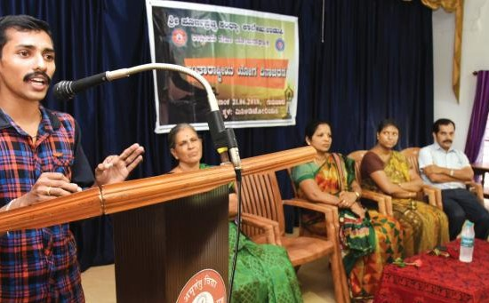
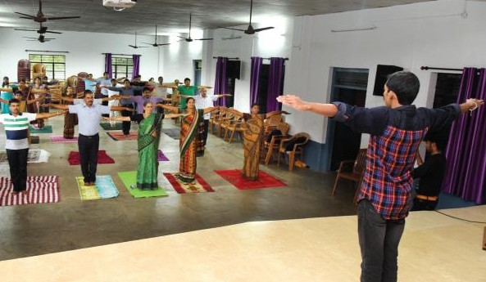
International Yoga Day Celebration on 21st June 2018
Chief guest :- Mr. Chinmay Kashyap

Slide 9
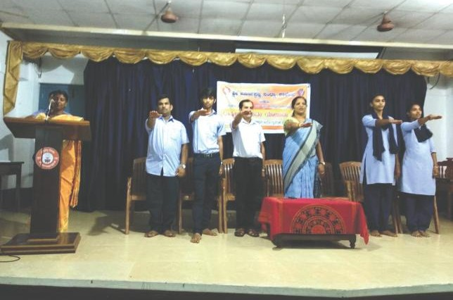
Oath taking by NSS Leaders on 2nd July2018

Slide 10
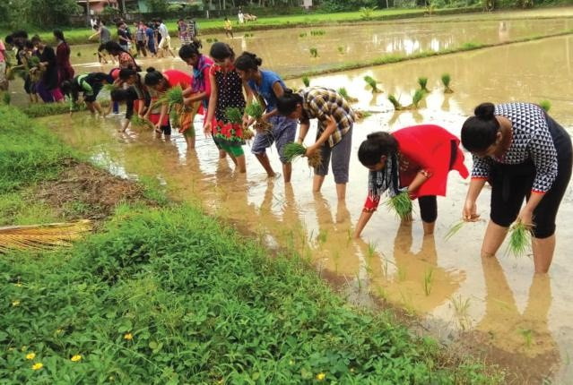
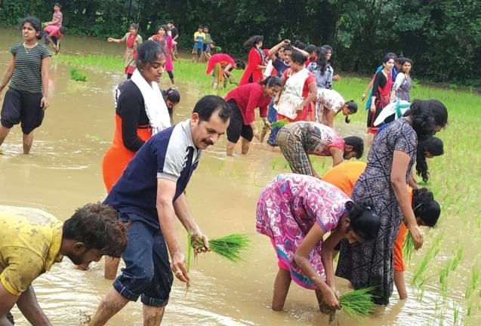
Naati Karyakrama held in kadiyali on 15th July 2018

Slide 11
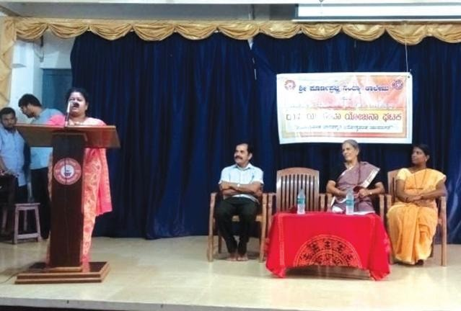
NSS Orientation Programme on 23rd July 2018
Chief guest :-Smt. Sowmya Shetty

Slide 12
Inauguration of NSS Activities on 27th August 2018
Chief Guest :- H H Sri Vishwapriya Theertha Swamiji,Mr.C K Manjunath

Slide 13
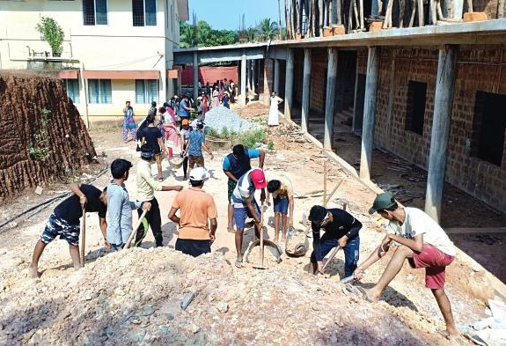
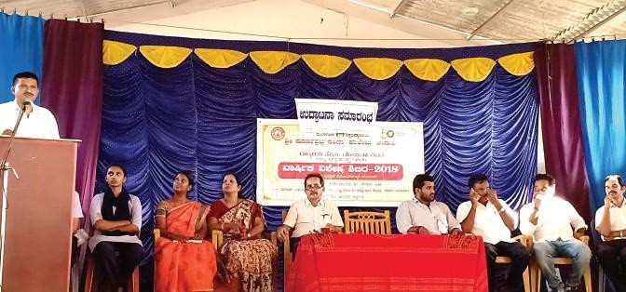
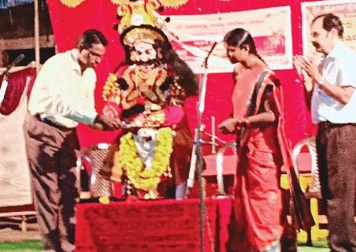
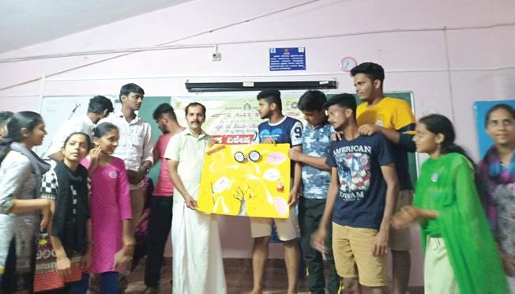
NSS Annual Camp 2018-19

Slide 14
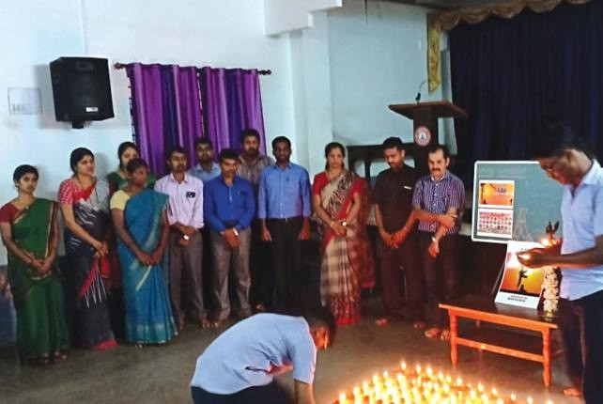
Paying Homage to Martrys of Pulwama Attack

Slide 15
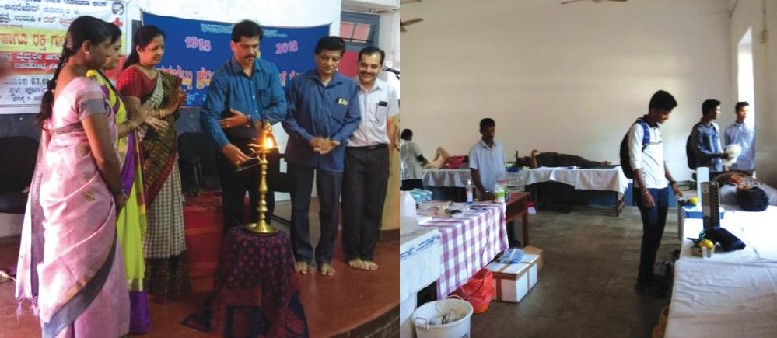
Blood Donation Campaign on 3rd March 2019
Chief guest :-Mr. Jayakar Shetty

Slide 16
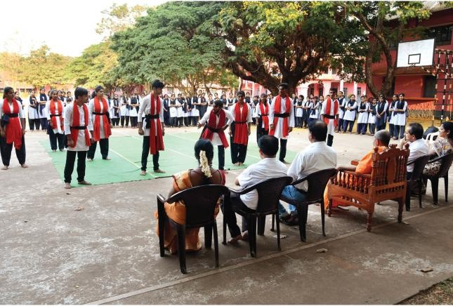
Street play by Students in the Campus on 10th April 2019

Slide 17
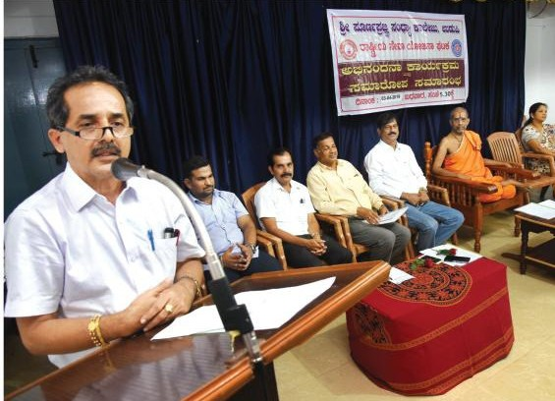
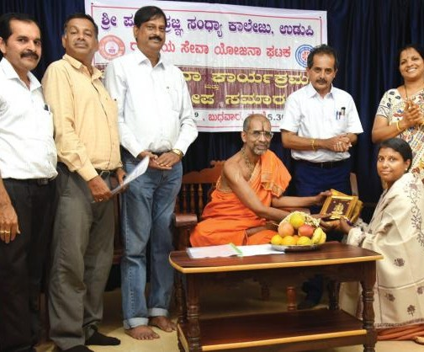
NSS "Samaaropa Samarambha" for the year 2018-19
Chief Guest :- H H Sri Vishwapriya Theertha Swamiji,Mr. Pradeep Kumar, Sri Aaroor Thimappa Shetty

Slide 18
Yuvagama held at MGM, Udupi on 29th September 2018
Our Volunteers secured first place in the competition.

Slide 19
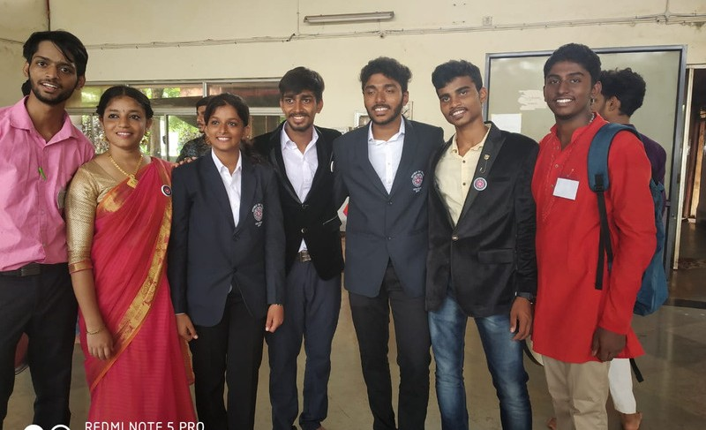
University Level NSS Leadership Camp in Konaje from 17th to 23rd July, 2018
Students Participated:-
Apoorva
Kiran
Unnati
Venkatesh Prasad

Slide 20
‘SRUJANA’ 2019 in Canara College , Mangalore on 16th September, 2019
Our NSS Volunteers won first place in poetry writing competition.

Slide 21
Academic Year 2019-20

Slide 22
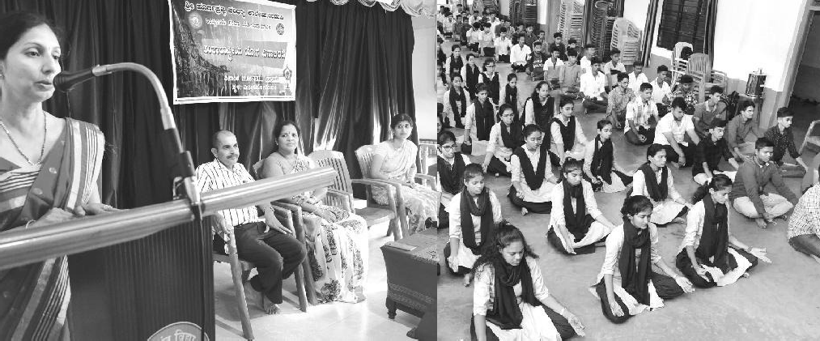
International Yoga Day Celebration on 21st June 2019
Resource person :- Smt.Sowmyashree.H

Slide 23
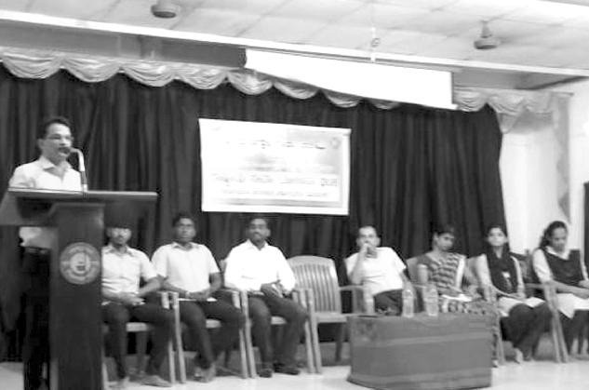
NSS Orientation Programme on 3rd July 2019
Resource Person:- Prof. Prakash

Slide 24
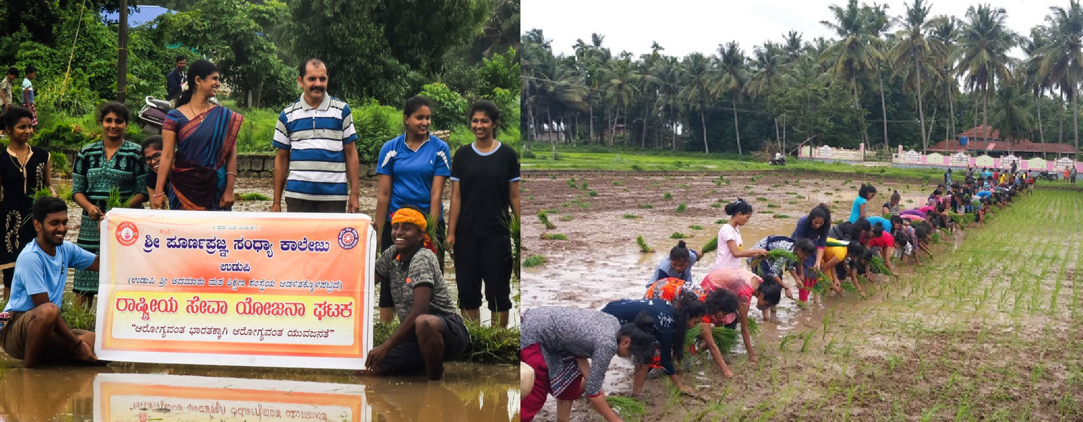
Naati Sambhrama held in Kota, Saligrama on 7th July 2019

Slide 25
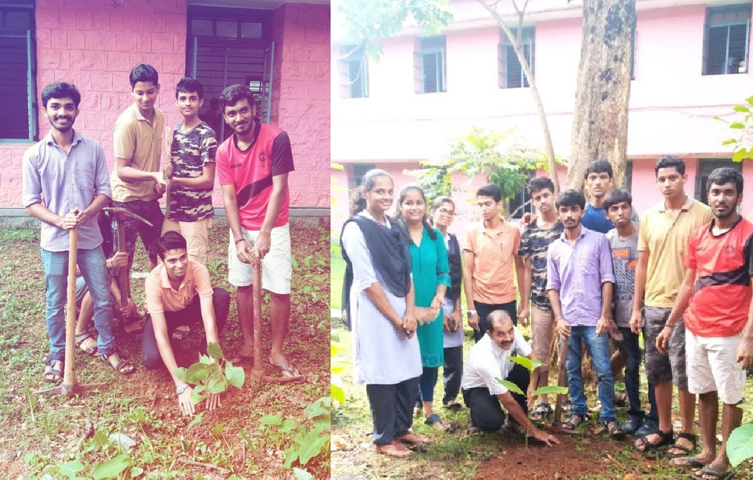
Vanamahotsava held at Poornaprajna College, Udupi on 12th July 2019

Slide 26
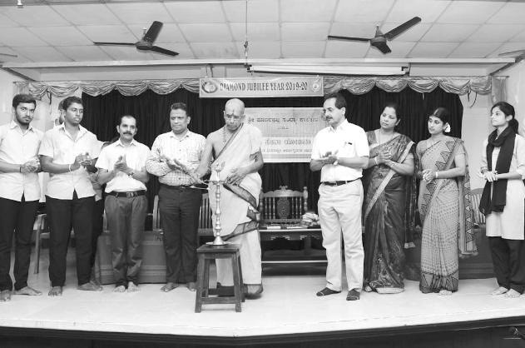
Inauguration of NSS Activities for the year 2019-20
Chief Guest:- H.H Sri Vishwapriya Theertha Swamiji , Dr. Bhaskar Shetty

Slide 27
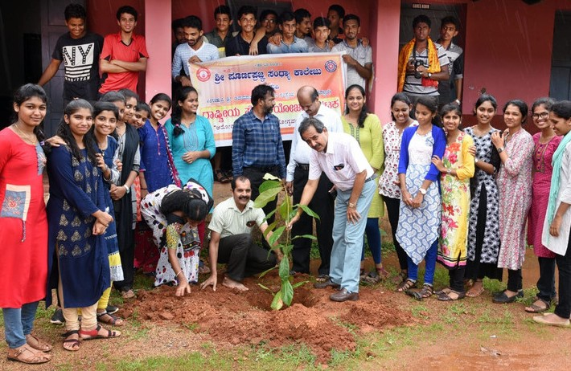
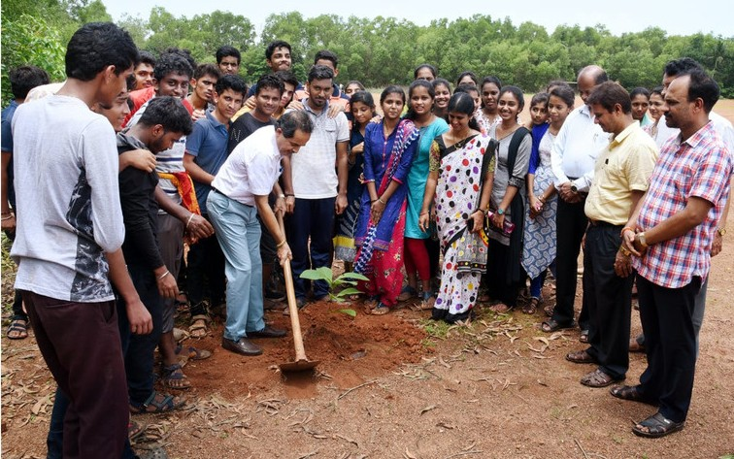
Vanamahotsava held at Poornaprajna College , Admar on
27th July 2019
Chief Guest:- Sri Pradeep Kumar

Slide 28
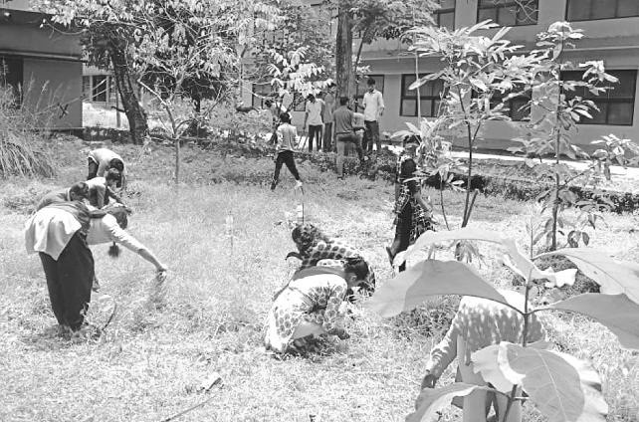
Campus Cleaning Programme for Independence Day on 15th August 2019

Slide 29
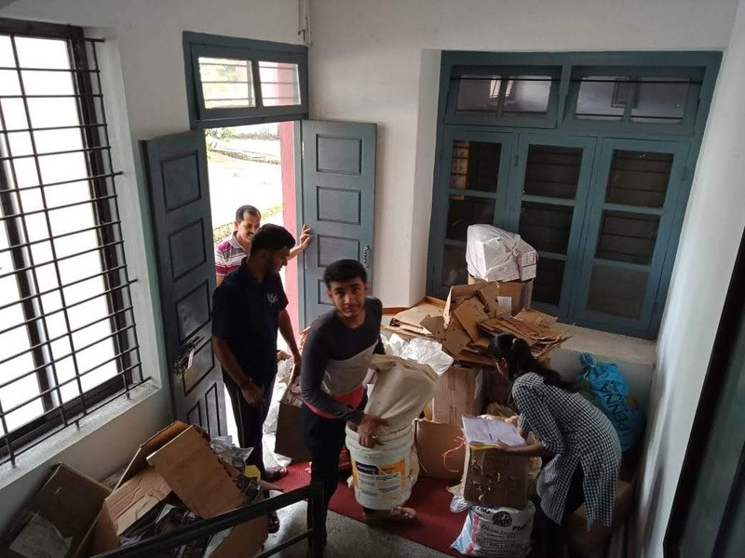
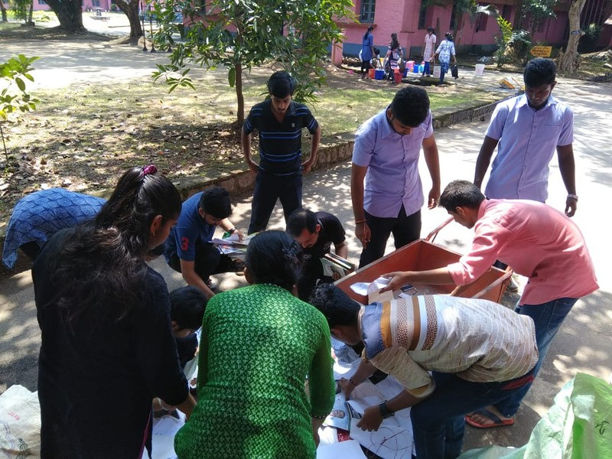
Waste Paper Management Campaign on 10th September 2019

Slide 30
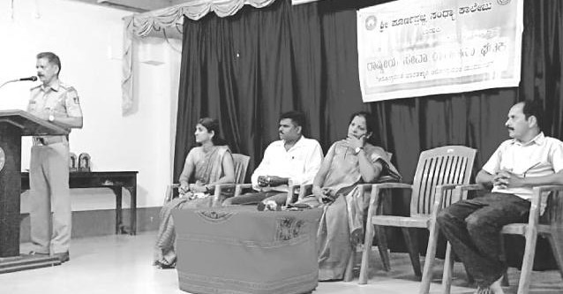
Road Safety Awareness Programme in the year 20th September 2019 Resource Person :- R.T.O Sri Vishwanath Nayak

Slide 31
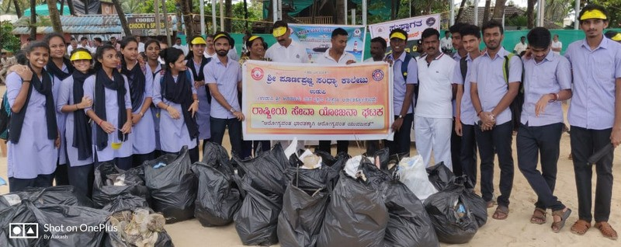
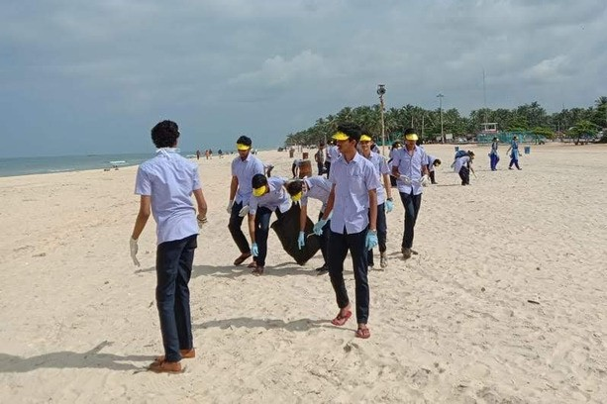
Beach Cleaning Campaign held on 21st September 2019

Slide 32
Fund Collected for the Welfare of Kodagu People on 29th September 2019

Slide 33
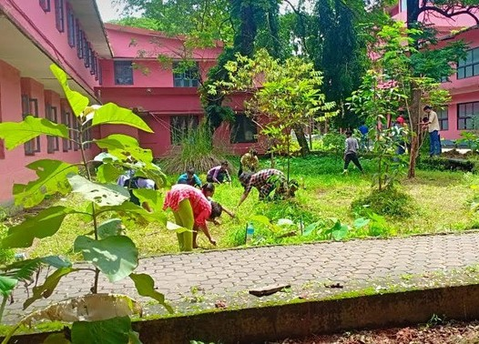
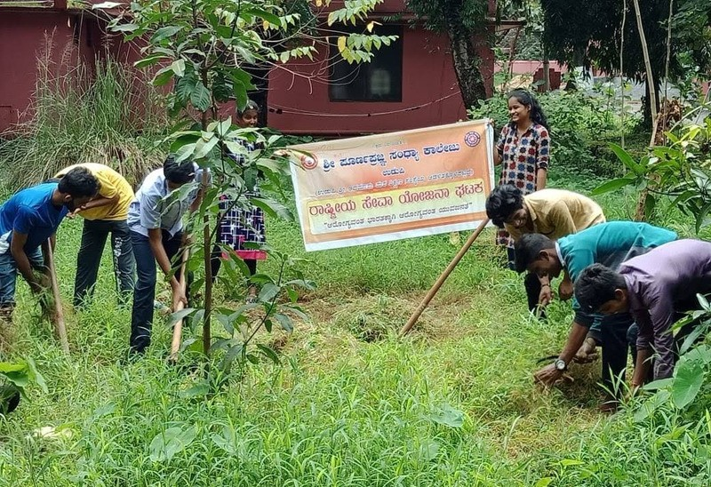
Campus Cleaning on the occassion of Gandhi Jayanthi on 2nd October 2019

Slide 34
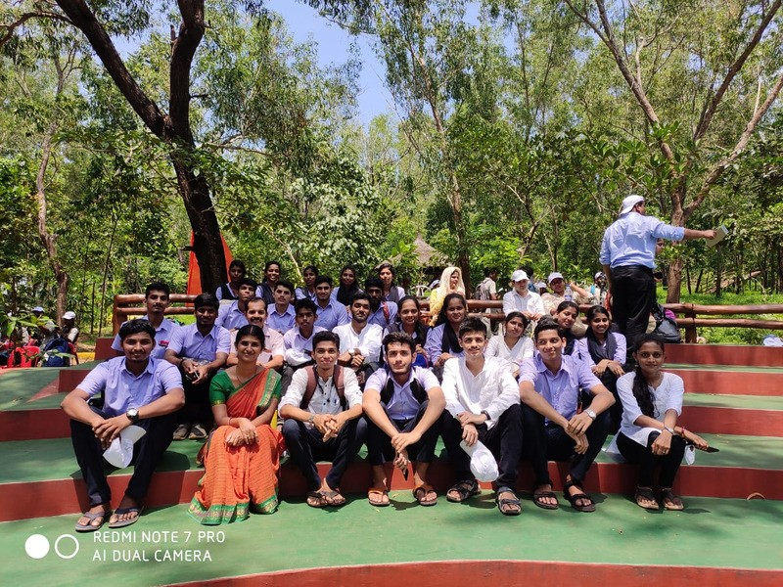
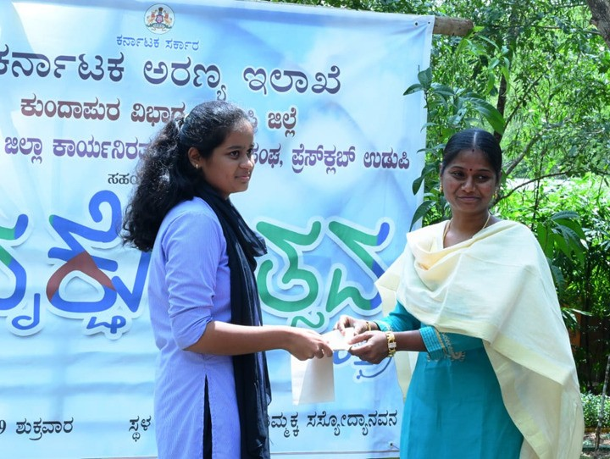
Vrukshotsava Celebration on 4th October 2019

Slide 35
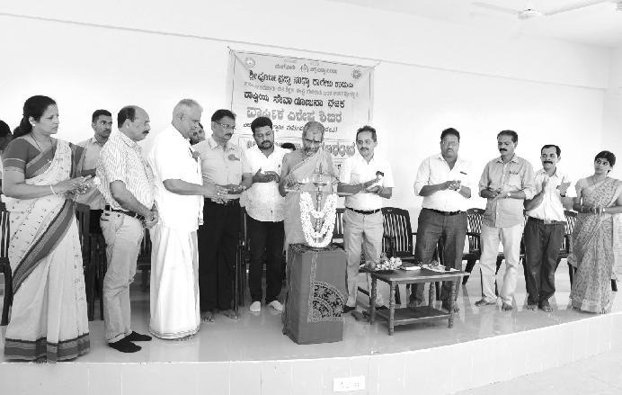
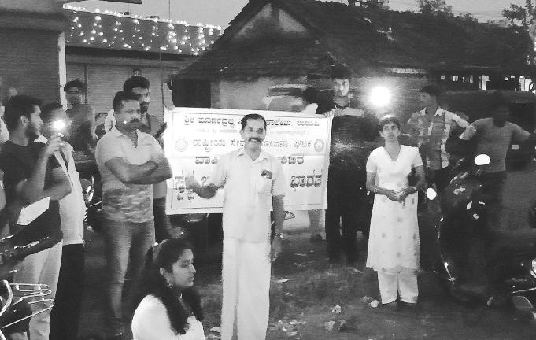
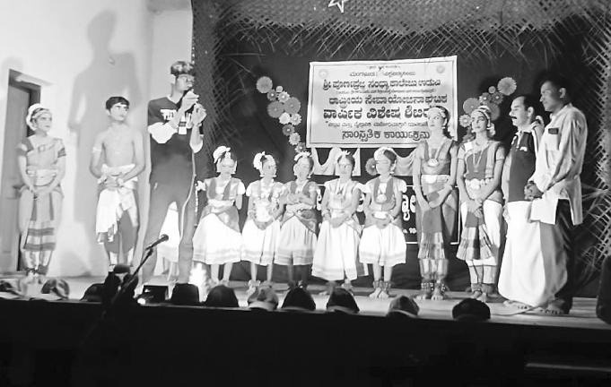
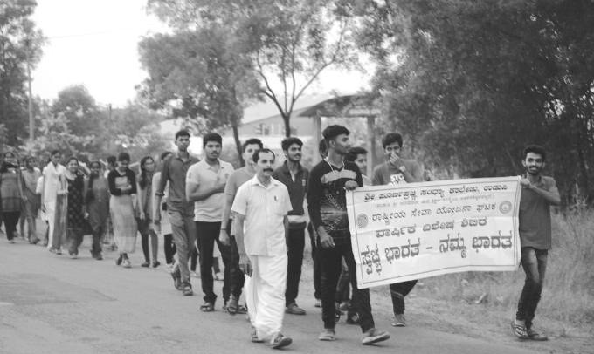
NSS Annual Camp 2019-20 from 21st to 27th December 2019

Slide 36
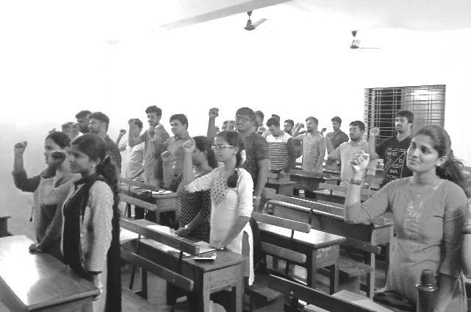
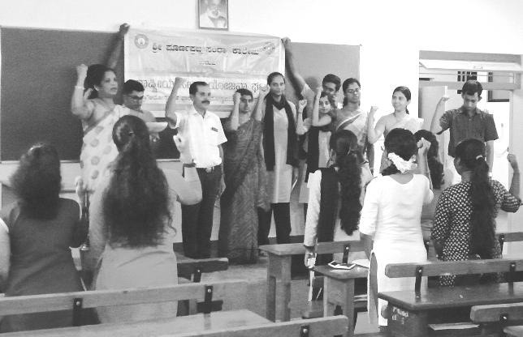
Anti-Tobacco Pledge By Staff and Students on 11th January 2020

Slide 37
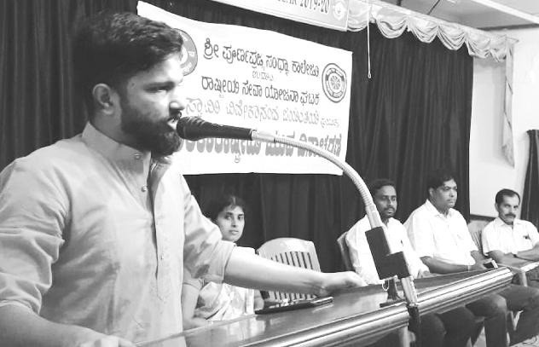
National Youth Day Celebration on 12th January 2020
Chief Guest:-Mr. Suprasad Shetty Resource Person:- Mr Karthik Kunder

Slide 38
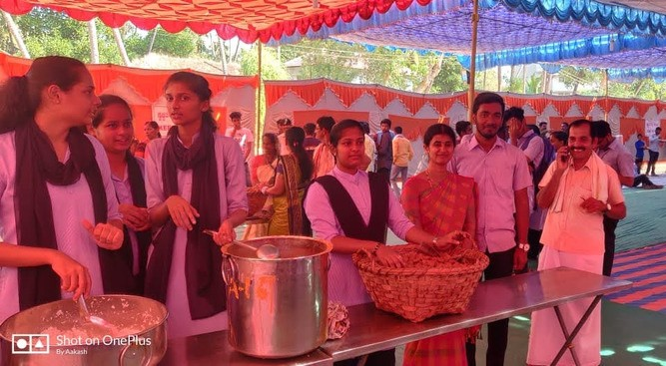
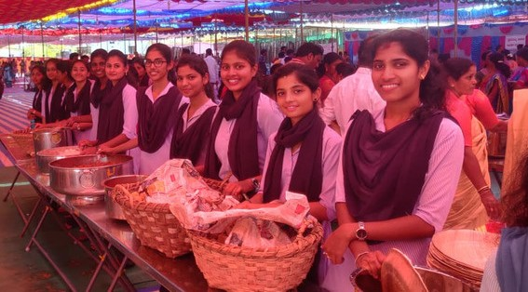
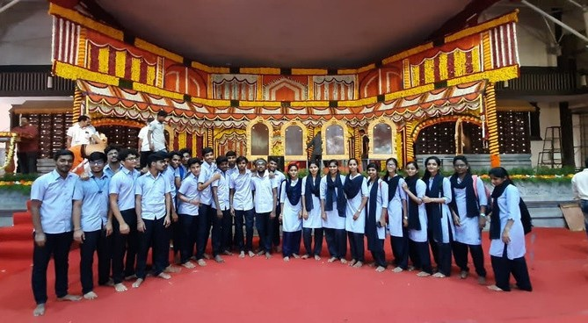
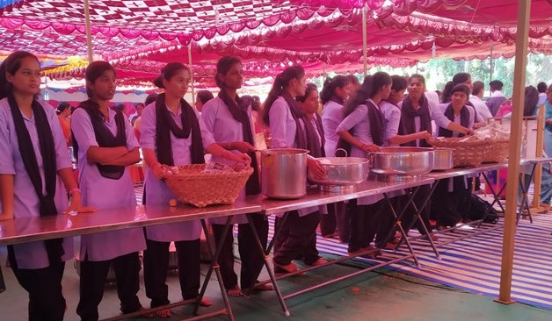
Shramadana on the occasion of Admar Mutt Paryaya 21st January 2020

Slide 39
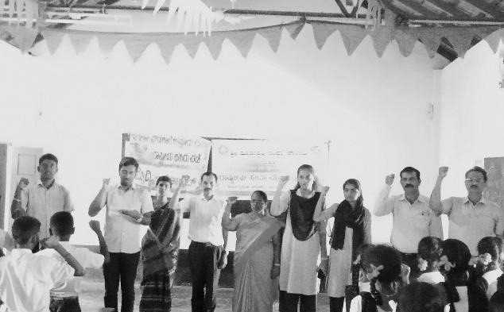
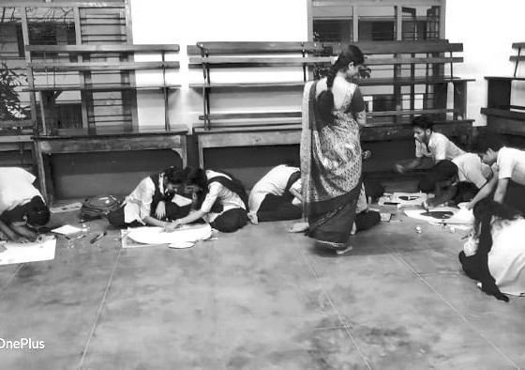
Anti-Tobacco Consumption Programme and Poster Making Competition held in Government High school ,Uppuru on 11th February 2020

Slide 40
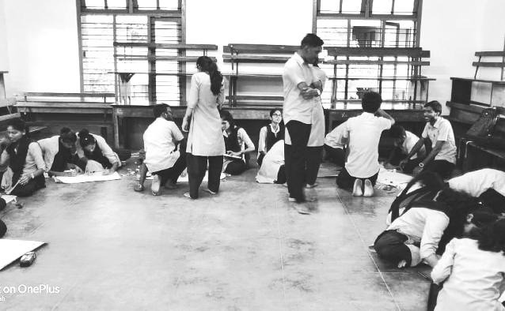
Aids Awareness Poster and Collage Making Competition on 12th February, 2020

Slide 41
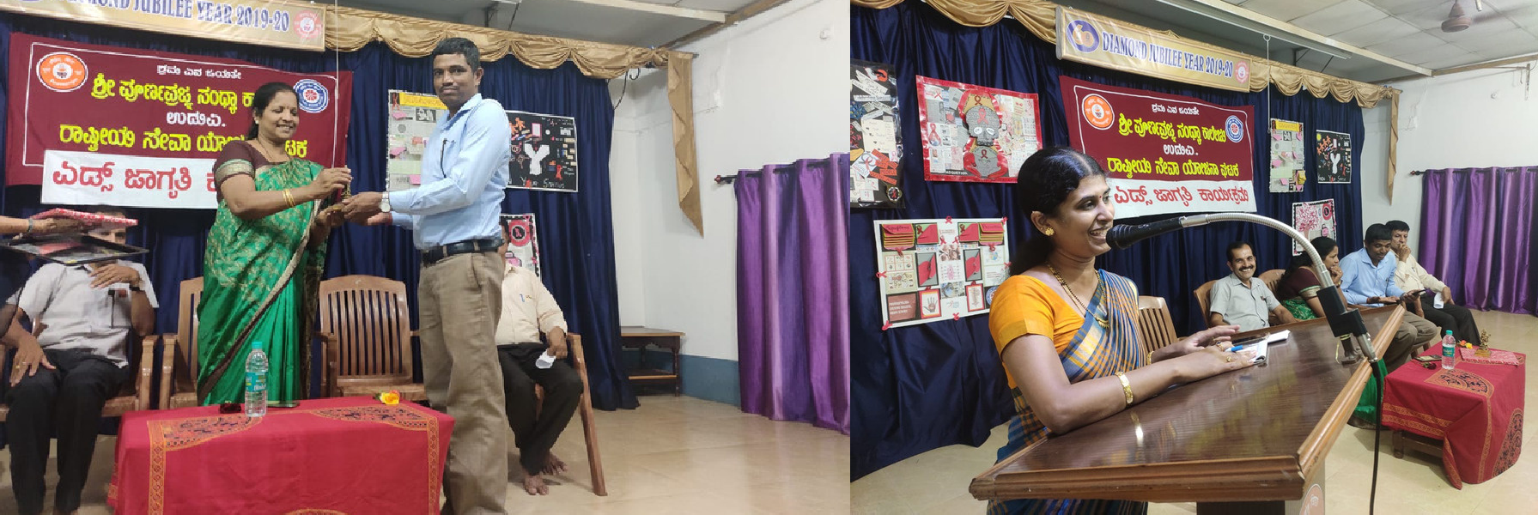
Aids Awareness Programme on
28th February 2020
Resource Person :- Sri Mahabaleshwar,Sri Sripati G U

Slide 42
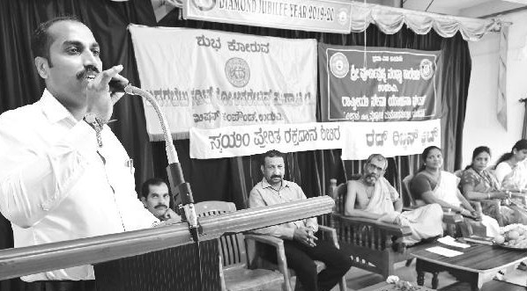
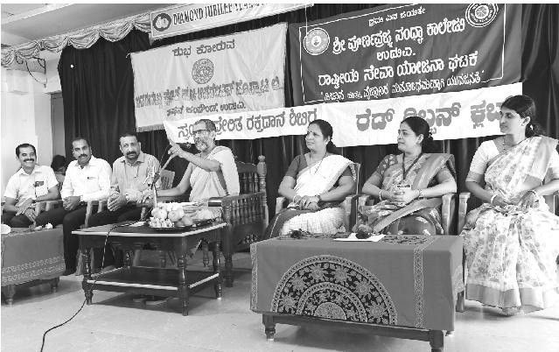
Blood Donation Campaign on 1st March 2020
Chief Guest :-H H Sri Vishwapriya Theertha Swamiji , Mr. Naveen

Slide 43
Yuva Jana Habba held by State NSS Unit from 10th to 14th September, 2019
Students Participated:
Maneesh
Pratheeksha

Slide 44
SRUJANA 2020 on 16th January, 2020 at Canara College, Mangalore
Students Participated:-
Maneesh, won second prize in Vag-jhari elocution competition.
Won second prize in Swarasinchana, group singing competition.

Slide 45
University Level NSS Leadership Camp in Konaje from 10th to 16th July, 2019
Students Participated:
Pannaga Navada
Venkatesh
Tilak
Vishrutha

Slide 46
Academic Year 2020-21

Slide 47
Inauguration of NSS activities on 18th february 2021
Chief Guest :-Sri Sri Vishwapriya Theertha Swamiji, Sri Pradeep Kumar, Sri Rajeev Shetty,Sri Aaroor Thimmappa Shetty

Slide 48
Belavanige-Samruddhi-Santhosha on 27th February 2021
Chief Guest :-Dr. Robert Clive

Slide 49
Anti-Raging Programme on 2nd March 2021
Chief Guest :-Mr. Shreekumar Chandra , Mr. Manjunath

Slide 50
Blood Donation Campaign on 07th March 2021

Slide 51
Fit India Freedom Run on 12th March 2021

Slide 52
Covid-19 awareness rally in udupi city on 23rd March 2021

Slide 53
World Environment Day Celebration at Govt. High School, Kolalagiri on 05th June 2021

Slide 54
International Yoga Day Celebrated on 21st June 2021
Chief Guest :-H H Sri Vishwapriya Theertha Swamiji , Mr Pradeep Kumar

Slide 55
Covid Vaccination 1st Dose Campaign 29th June 2021

Slide 56
Campus Cleaning on the occasion of Independence Day on
15th August 2021

Slide 57
Covid-19 Vaccination 2nd dose Campaign 25th August 2021

Slide 58
Academic Year 2021-22

Slide 59
Malpe Beach Cleaning Campaign on 17th October 2021
Resource person :- Smt Usha Sharma

Slide 60
Karnataka Rajyotsava Celebration on 1st November 2021
Chief Guest :- Mr. Pradeepchandra

Slide 61
Constitution Day on 26th November 2021
Chief Guest :-Prof K.Surendranath Shetty'

Slide 62
Paryaya 2022 at Shri Krishna Matha,Udupi

Slide 63
Blood Donation Campaign on 26th January 2022
Chief Guest :- H. H Sri Vishwapriya Theertha Swamiji , Sri Jayakar Shetty, Dr. Veena Kumari 'AMEC'

Slide 64
NSS Annual Camp 2022 at Perdoor

Slide 65
Amrithabharathige Kannadada Aarathi on 28th May 2022 at Ajjarkad,Udupi
Chief Guest :- Mr.Prathap Shimha

Slide 66
Kesar 'd onji Dina 3rd July 2022 at Bailoor Chief Guest : H.H Sri Eeshapriyatheertha Swamiji, Mr. C.A. T. Prashant Holla, Kudi Srinivasa Bhat, Sri Srinivasa Acharya, Shri Vasant Kotian.

Slide 67
"Save Soil Movement" Awareness Programme on 16th July 2022
Resource Person :- B N Venkatesh

Slide 68
Kargil Vijay Diwas Celebration on 28th July 2022
Resource Person :- Prakash Malpe

Slide 69
Independence Day Rally on 13th August 2022
from Poornaprajna College to Mahatma Gandhiji Mantapa
Chief Guest :- Mr. Vishak G Shetty

Slide 70
Har Ghar Tiranga Campaign on 15th August 2022

Slide 71
Environmental Awareness Through Documentary Video on 16th August 2022

Slide 72
Booster Dose Campaign on 16th August 2022

Slide 73
Sadhbhavana Dina-Oath taking on 18th August 2022

Slide 74
Academic year 2022-2023

Slide 75
Outreach Programme at Spandana Rehabilitation Center, Uppoor on 22nd October, 2022
Chief Guest : Mr Umesh, Mr. Janardhan

Slide 76
Karnataka Rajyotsava Celebration on
2nd November, 2022
Chief Guest : Mrs. Poornima Suresh

Slide 77
Voter's Right Awareness Rally on
9th November, 2022
Support & Motivation : Dr. Sukanya Mary J

Slide 78
Pond Cleaning Programme at Doddanagudde, Ajjarkad on 16th November, 2022
Chief Guest : Mr. Ravikumar

Slide 79
Special Talk on Job opportunities in Film Industry on
5th December 2022
Chief Guest : Mr. Kishore

Slide 80
NSS Inauguration on 17th December, 2022
Chief Guest : Dr. Sukanya Mary J, Mr.Gananath, Mr.Prashanth

Slide 81
Youth Day Celebration on
12th January, 2023
Chief Guest : Mr.Karthik Kundar

Slide 82
Blood Donation Camp on 29th January, 2023
Chief Guest :Dr. Shami Shastri, Dr. M K Bhat, Mohan Shetty,Santhosh Shetty

Slide 83
NSS Annual Camp held from 2nd March to
8th March, 2023
Chief Guest : H.H Sri Eeshapriya Theertha Swamiji, CA.T Prashanth Holla, Dr. Sukanya Mary J, Mr.Pundarikaksha Kodancha, Mr. Anantha Muditthaya, Mr. Nataraja Upadhyaya, Mrs. Mallika Acharya.

Slide 84
Campus cleaning at the camp site

Slide 85
Grama sameekshe of Innanje village 02nd March 2023

Slide 86
Theatre play session on 03rd march 2023
Chief guest : Mr. Pradeep Chandra, Mr. Mervin Shirva

Slide 87
Special talk on Self-awareness on 04th March 2023
Chief guest : Mr. Chandrakanth Bhat

Slide 88
Mind Kraft-Fun & Win on 04th march 2023
Chief guest : Mrs. Jayalakshmi

Slide 89
Kaup beach cleaning on 04th March 2023

Slide 90
Medical Camp conducted on 05th March 2023
Chief guest : Mr. Dinesh Shetty

Slide 91
NSSnalli ‘Kalike Nalike’ on 05th March 2023
Chief guest : Mr. Shrinivas Vaidhya

Slide 92
Special talk on importance of positive thinking in student life on 5th March 2023
Chief guest : Mr. K Mahesh Shenoy

Slide 93
Hike to Renjalapaade on 05th March 2023

Slide 94
Cleaning programme at Sri Durgaparameshwari temple Bantakal, on 6th March, 2023

Slide 95
Visit to Manasa Rehabilitation center, Pamboor on 6th March 2023

Slide 96
Street play by NSS volunteers on 6th March 2023

Slide 97
Cleaning programme at Sri Shambhushaileshwara temple Shambhukallu, on 7th March, 2023

Slide 98
Special talk on Historical importance of Udyavara on 7th March, 2023
Chief guest : H.H Sri Eeshapriya Theertha Swamiji, CA T.Prashanth Holla, Dr. B Jagadish Shetty

Slide 99
Celebration of Ambedkar Jayanti on 14th April, 2023

Slide 100
World Environment day celebration on
05th June 2023

Slide 101
World Blood donors’ day celebration on
14th June 2023
Chief Guest : Vishak G Shetty

Slide 102
Survey of Youth Not In Formal Education or Regular Employment conducted on 13th July 2023

Slide 103
Har Ghar Tiranga campaign on 15th August 2023

Slide 104
‘Vasudha Vandana’ campaign on 17th August 2023

Slide 105
‘Yuvajanotsava’ 2023-24 on 27th August 2023

Slide 106
‘Miracle Forest challenge’ webinar on 27th August 2023
Chief guest : H.H Sri Vishwaprsanna Theertha Swamiji, Dr. Ravindranath Shanbhag, Mr. K Mahesh Shenoy

Slide 107
THANK YOU

