Slide 1
Cultural Association
Sri Poornaprajna Evening College, Udupi

Slide 2
Mrs. Gowri Shenoy, Dept of Commerce is the coordinator of this association.
1. Variety of cultural events were held on occasion of Kannada Rajyothsava program in our college mini auditorium on 01-11-22
2. Various cultural events was performed by the students at Students Council inauguration on 07-12-22
3. Cultural Association had conducted "Freshers' day on 6/01/ 2023.
4. Association conducted various cultural competition in the college from 18-04-23 to 21-04-23 such as singing, dancing, drawing, story, poem, essay writing etc.

Slide 3
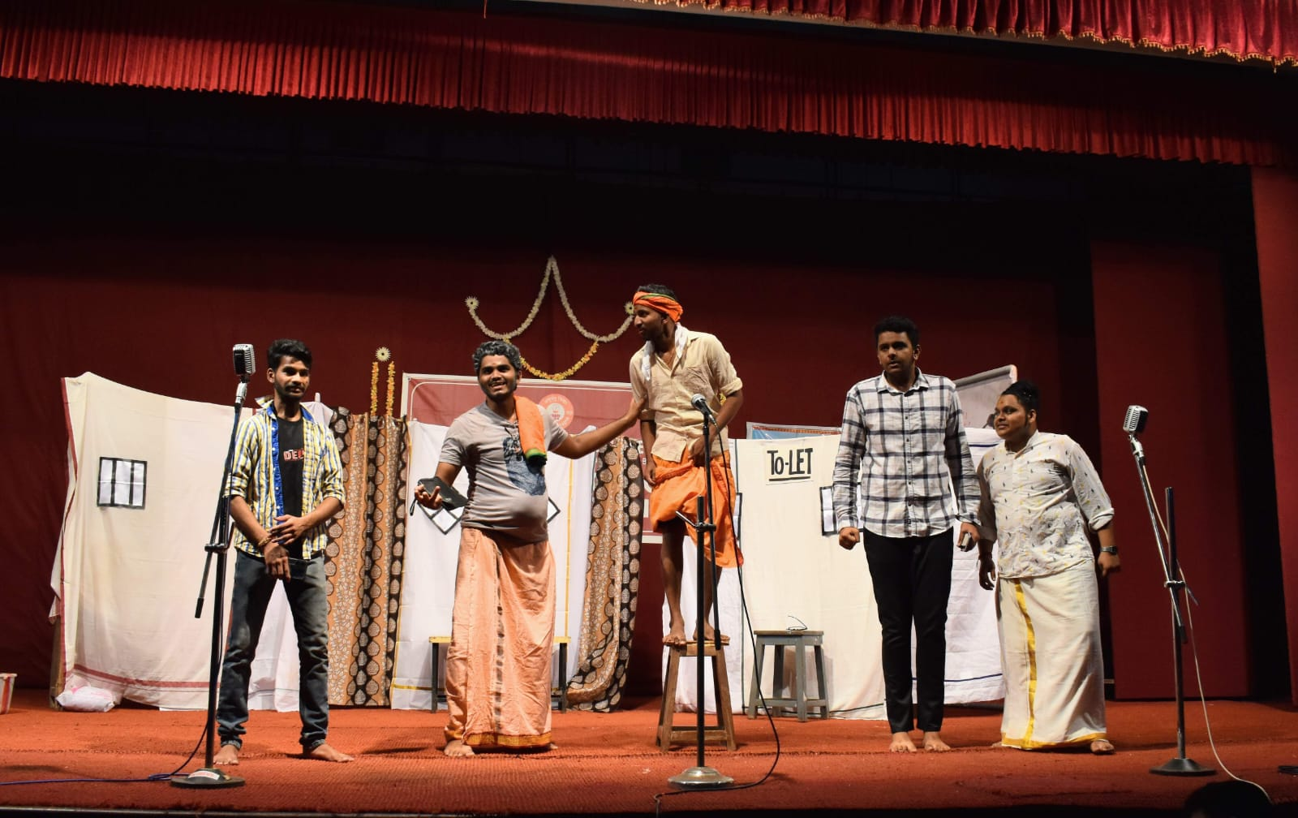
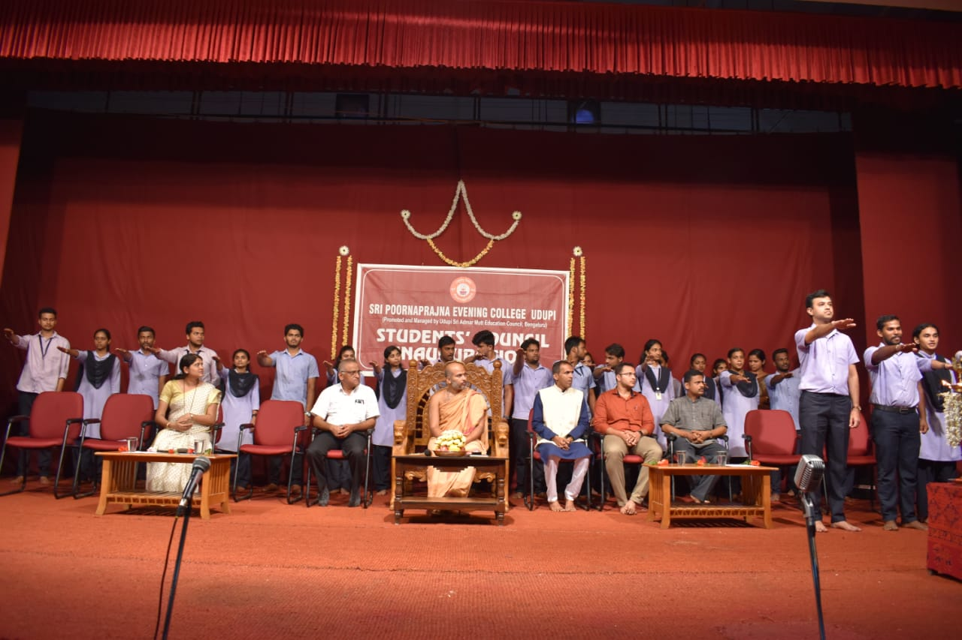
Students’ Council inauguration & Cultural Programs.

Slide 4
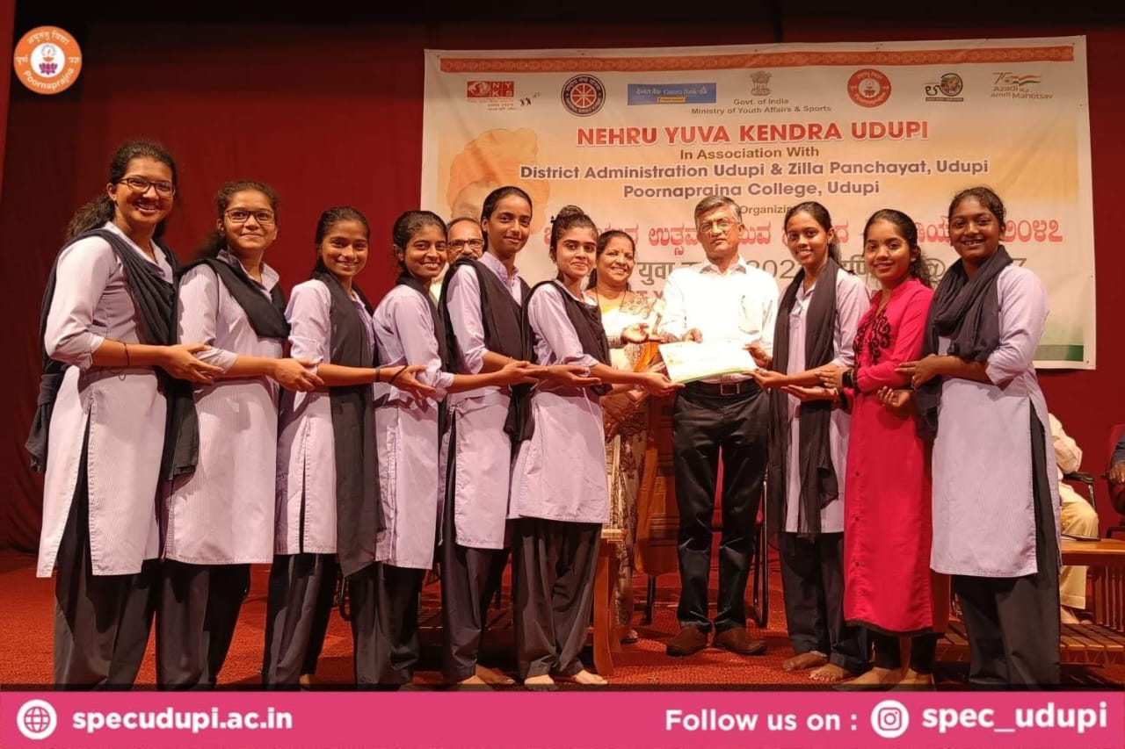
UG Students Achievements:
1. “Yuva Utsav- Yuva Samvad Fest” held on 21-10-2022 organized on the occasion of District Yuva Utsav 2022 held at Poornaprajna College, Udupi on the theme of “Take pride in our Heritage and Legacy”.
• Our dance team won first Place in
cultural festival Group Dance.
• And won 3rd place in Poem Writing.
2. "Taluk Level Essay Competition”
held on 21st November 2022 at Dr. G Shankar govt. Women's First Grade College & PG Study centre Ajjarkadu, Udupi on occasion of National Voters Day celebration on 25th January 2023.
• secured 3rd place in Kannada essay
writing.

Slide 5
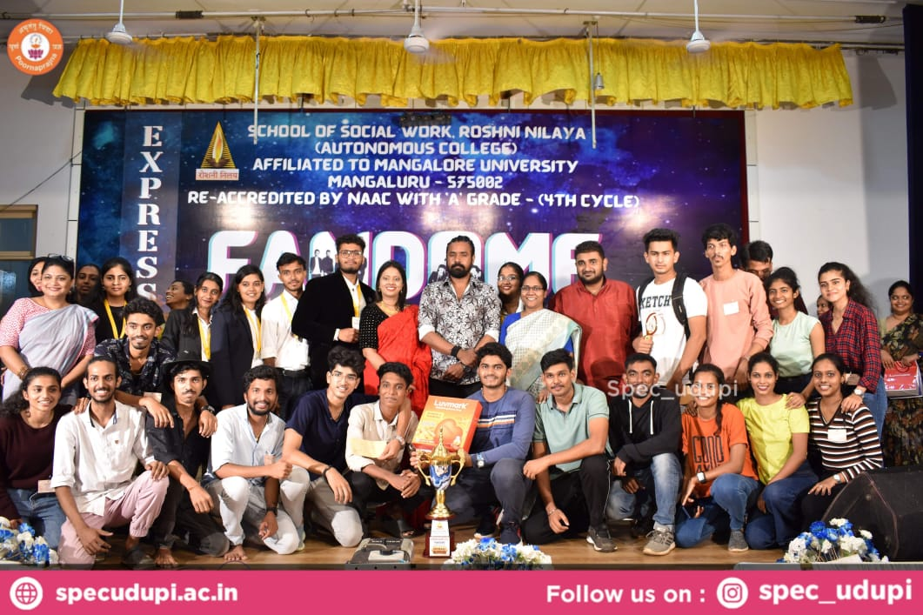
3. ‘FANDOME’ To infinity and beyond. A National Level UG inter collegiate talent quest held at Roshini Nilaya school of social work Managalore held on 25 -11-2022.
• won 2nd place in photography and
cooking without fire.
won 1st place in Mock Press and Reel
making.
The college also won” Overall runner up” championship for the event.

Slide 6
4. “Swarasangama-2022”
A University level singing fest held at Dr. Shankar Govt.Women’s First Grade College And P.G Study centre Ajjarkadu, Udupi held on 1st December 2022.
The singing team won 1st place in group singing.

Slide 7
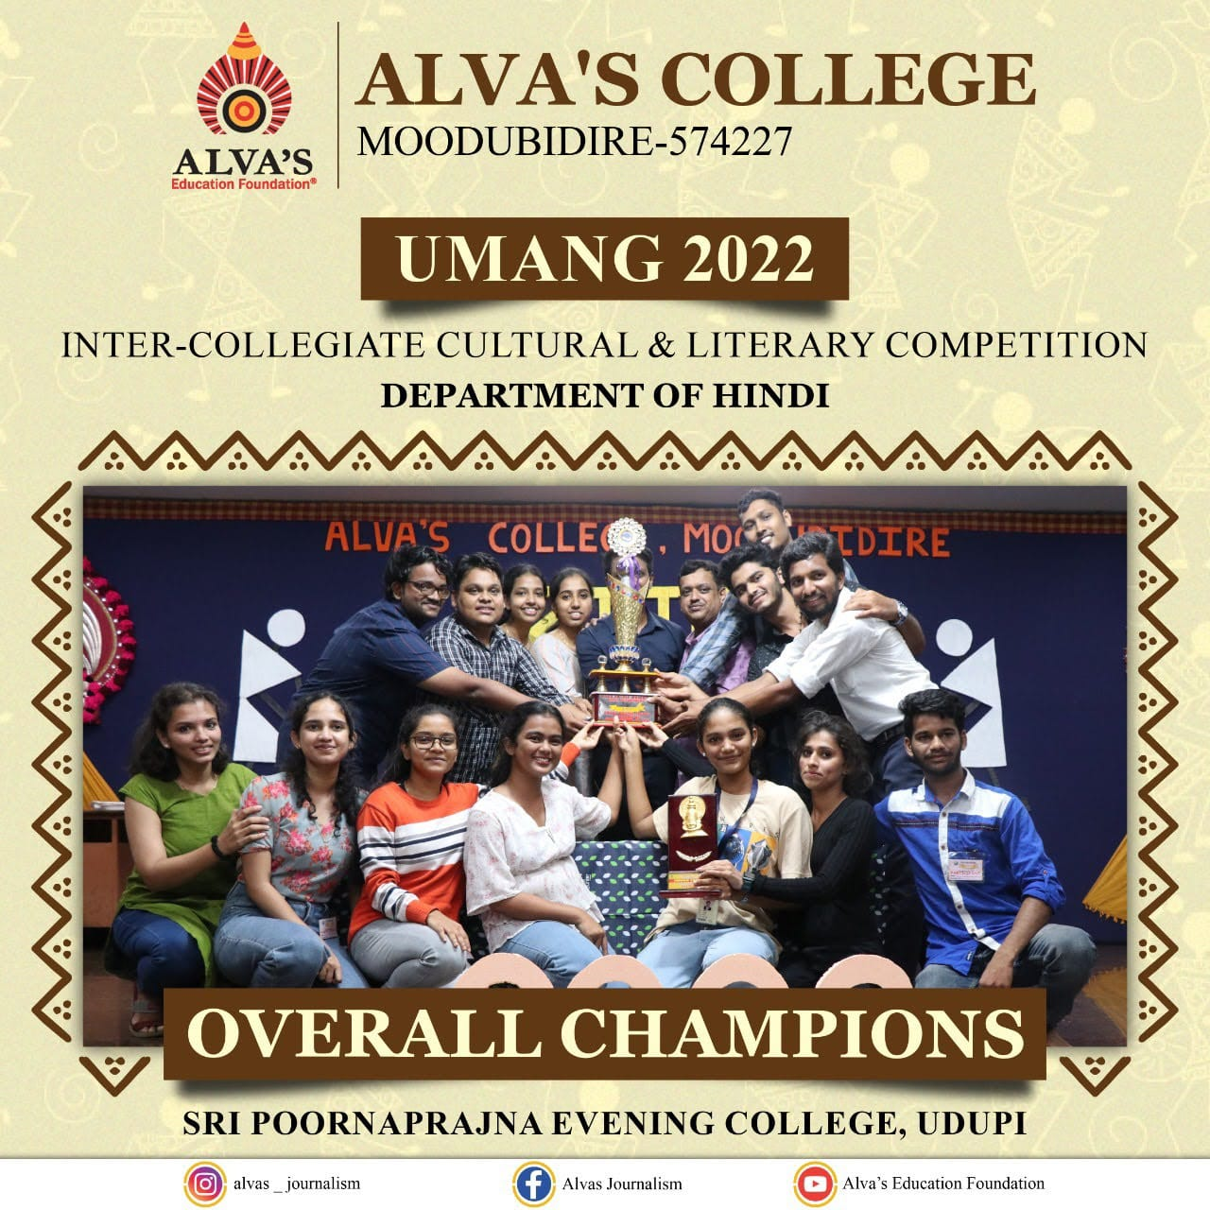
5. "South East Zone Youth Festival" held at Gulbarga on 27th to 31st January, 2023.
Durgadheesh Hebbar of 3rd B.com participated in photography event.
6. “UMANG 2022-23”
Inter collegiate Hindi fest held on 03-12-2022 at Alva’s College Moodubidre .
• secured first in Face painting and group
dance.
The College also won “overall championship” for the event

Slide 8
7. “Speak for India” contest A district level of speak for India- Karnataka edition, A state level inter collegiate debate competition held on 9-1-2023 at Milagres College kallianpur. Our students participated in Speak for India contest.
8. "Fest – 2022" held on 12th December 2022 at Dr. G Shankar Govt. Women’s First Grade College And P.G Study centre Ajjarkadu, Udupi.
• Secured 2nd place in Poster Making.

Slide 9
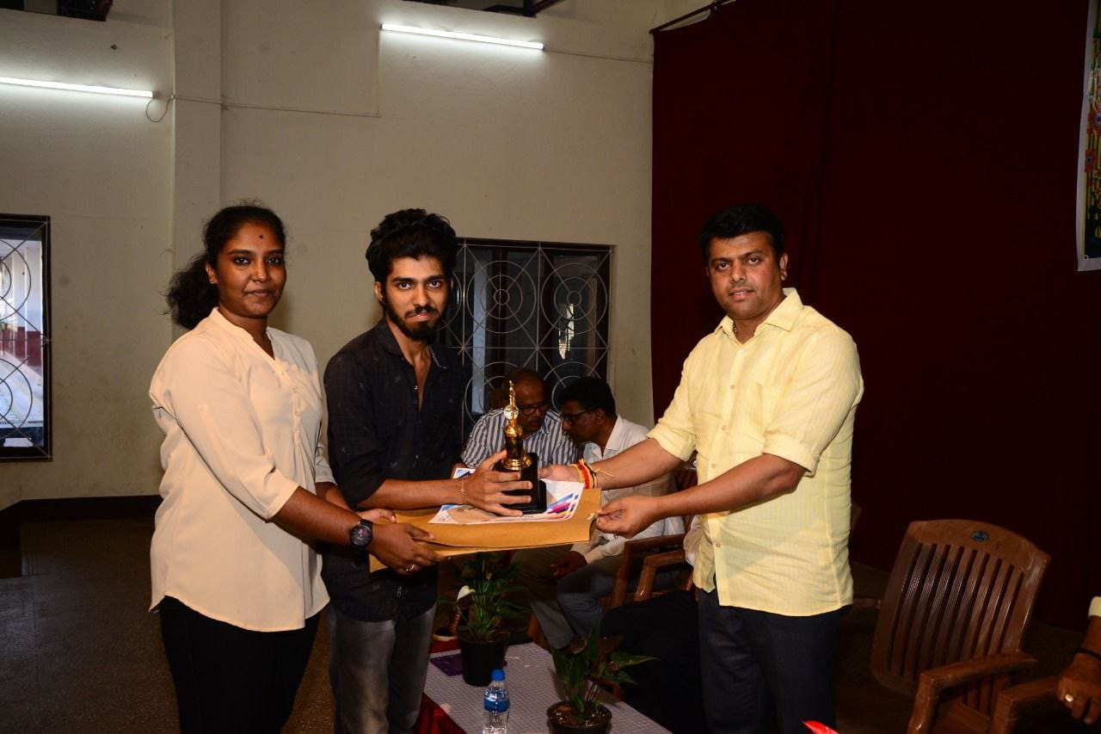
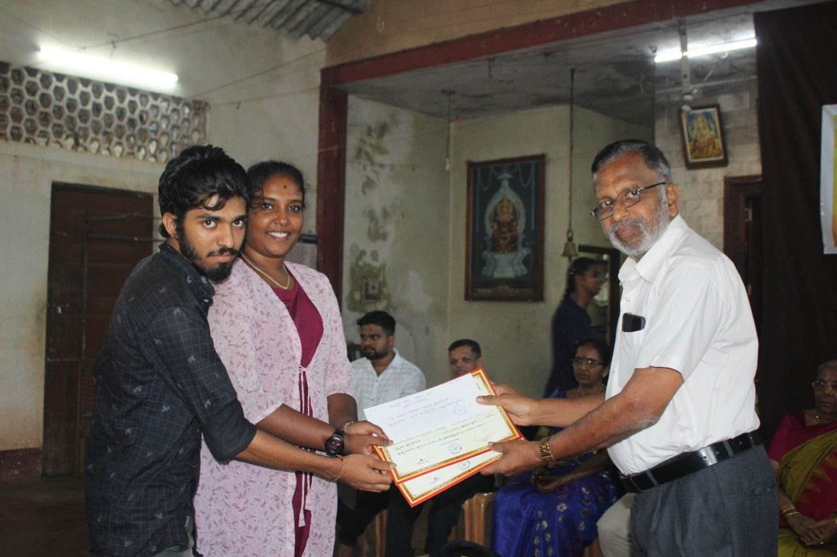
9. “Quiz competition” University level inter collegiate competition on occasion of National Youths Day held by Bunts Hostel Shri Ramakrishna first Grade College Mangalore on 12th January 2023.
• won 3rd place in Quiz competition.
10. “Lions kannada kalarava”
University level inter collegiate cultural competition by Lions kannada kalarava Town hall Mangalore on 13th January 2023 .
• won first Place in Variety & Quiz competition.
11. District level “Quiz Competition” organized by “Shri Kalikamba Bhajana Sanga” Kodavoor, Udupi on 15th January 2023

Slide 10
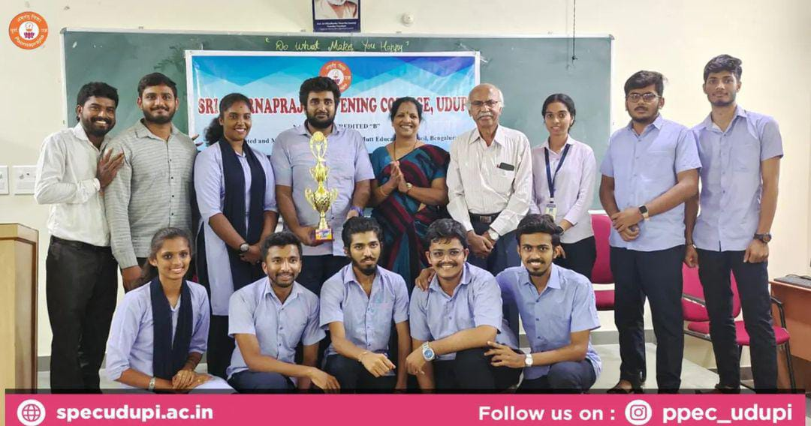
12. "SPLASH" The Management fest organized by PG Department of Shri Poorna prajna Evening College, Udupi on 3rd and 4th February 2023.
• Won 1st place in Badmash Company,
The wall Street and in Quiz.
The College also won Overall Championship for the event.

Slide 11
13. "INCIDENT-2K23”
A state Level Inter Collegiate Fest organized by National Institute of Technology, Surathkal held on 19th March 2023.
• Secured 1st place in Fashion-Show.

Slide 12
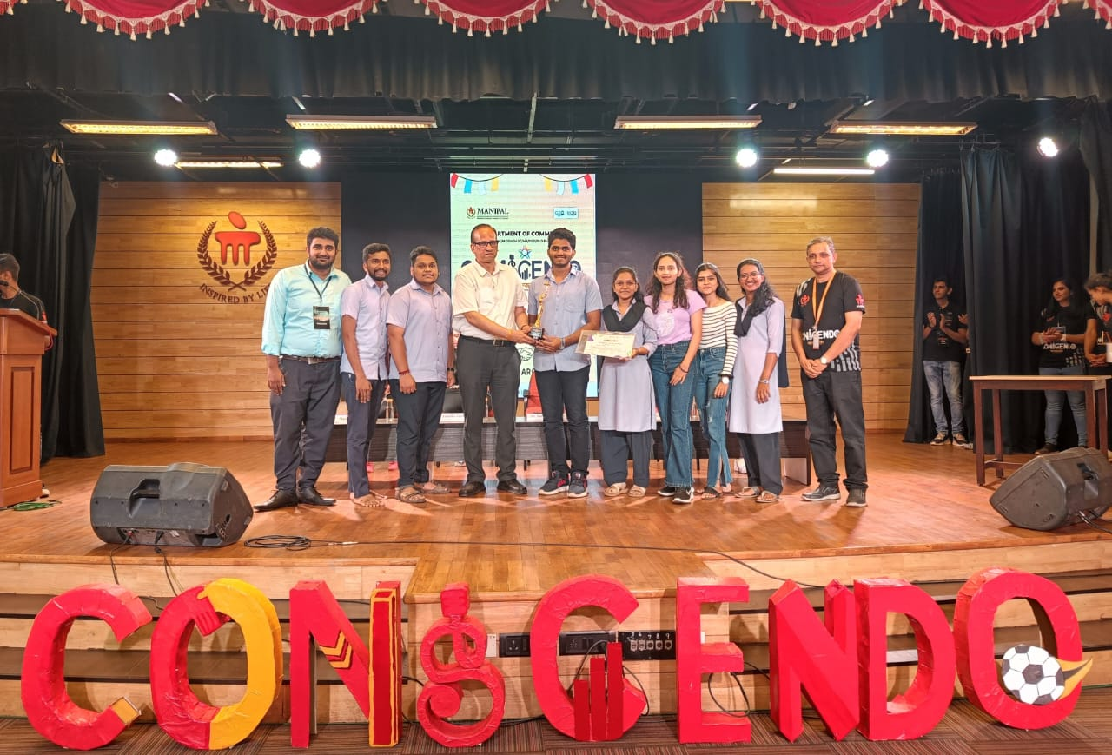
14. “MAHE DOC FEST(Management)CONSCENDO” National Level inter collegiate fest held on March 30th, March 31st & April 1st at Manipal Academy of higher education, Manipal.
• secured 1st place in Best manager and in Fashion
show.

Slide 13
15. “RANGA SAMAAGAMA- 2023”
held at Journey Theatre group, Mangalore on 1st April 2023. Our student participated in the workshop.

Slide 14
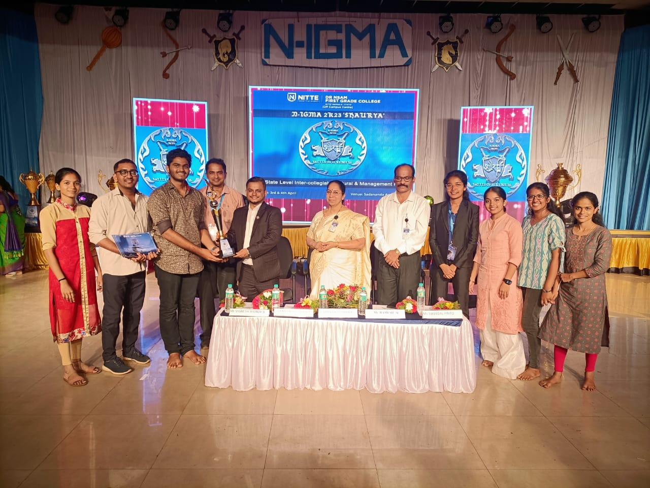
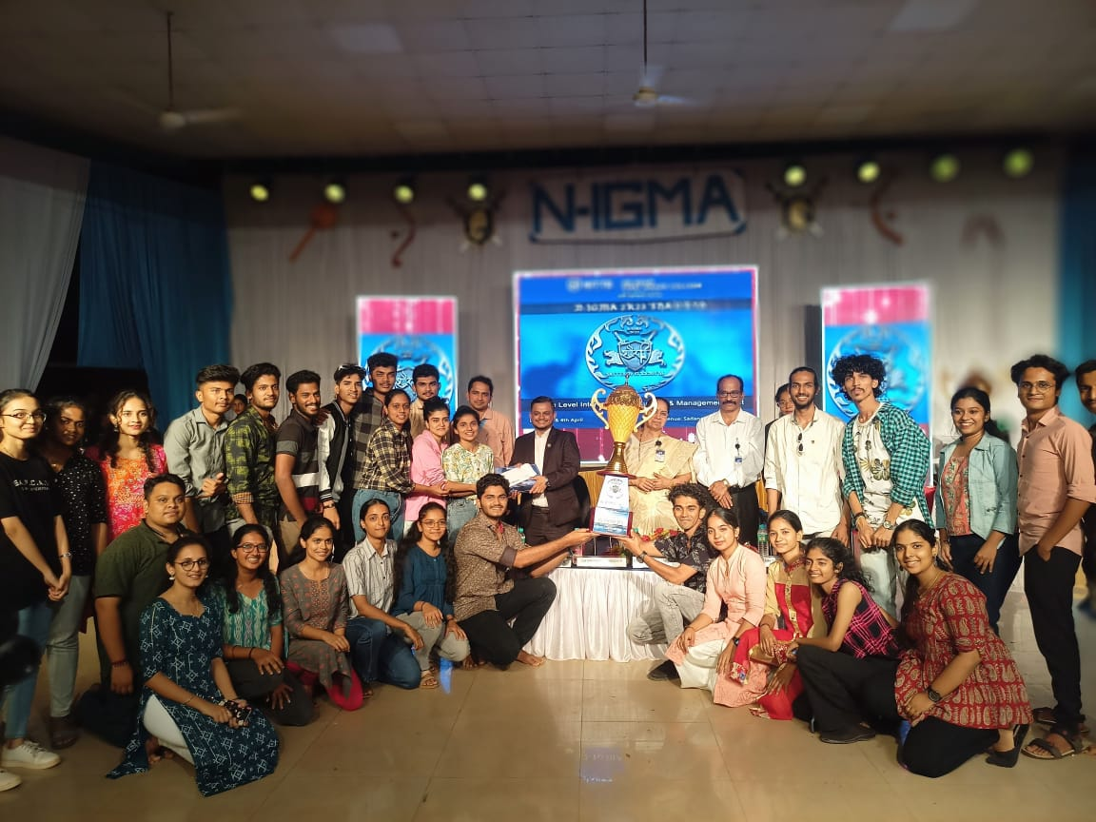
16. “N-IGMA ‘Shourya’ Fest” held at Dr. NSAM First Grade College Nitte, Karkala on 3rd and 4th April 2023.
• Our dance team won 1st place in group dance .
• Our singing team won 2nd place in singing competition.

Slide 15
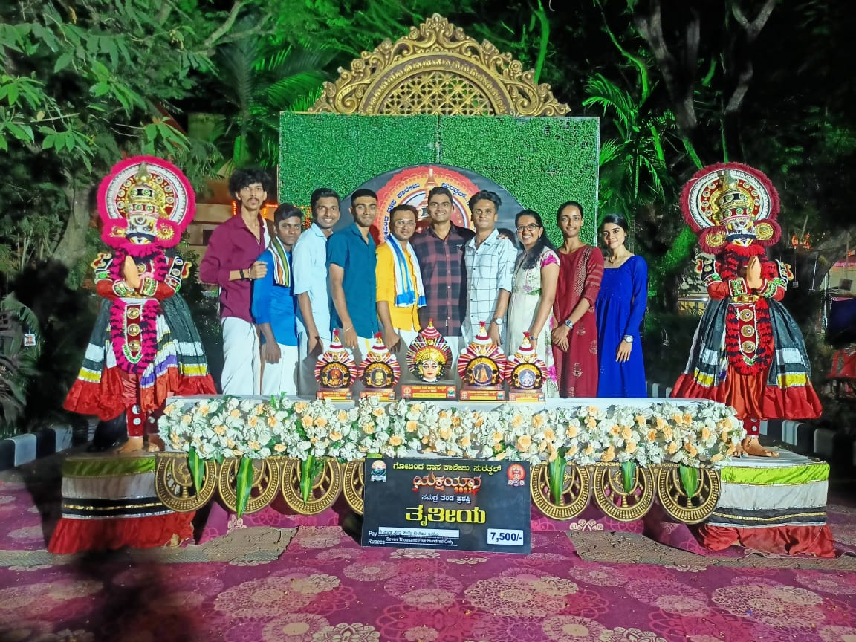
17. "Inter Collegiate Yakshagana Competitions”
Organized by Govinda Das college surthkal held on April 7 2023.
Secured 1st place in Bannada Vesha and Sthree Vesha
• Secured 2nd place in Punduvesha and
Rajavesha.
The college also won Overall Championship for the event

Slide 16
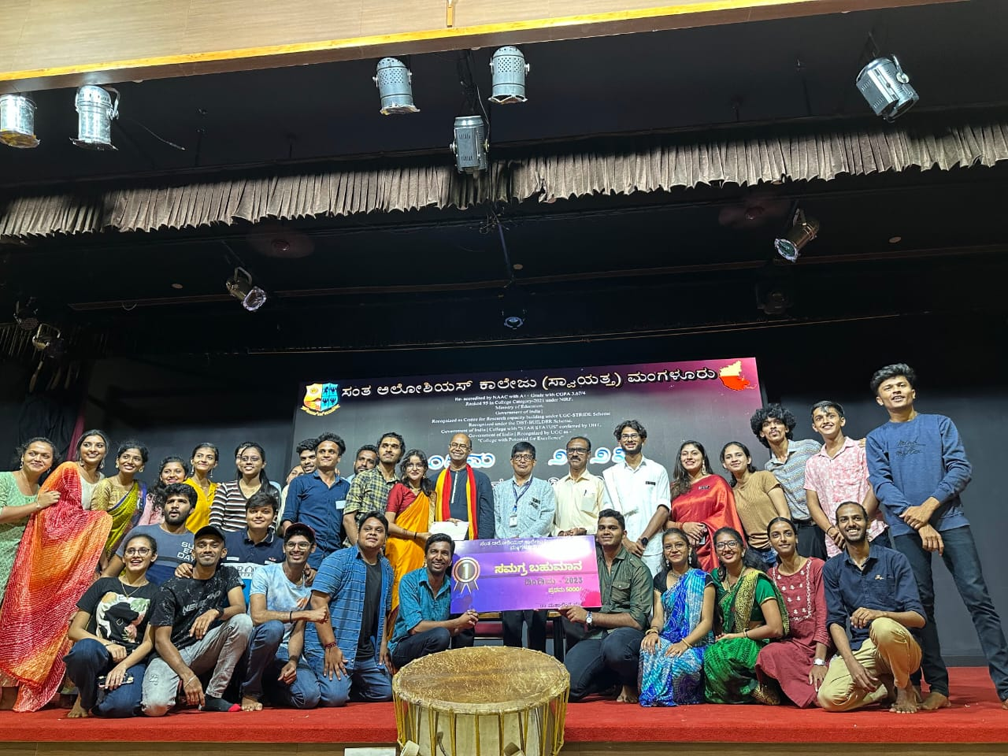
18. "DINDIMA-2023" Inter collegiate fest, organized by kannada department of St. Aloysius college on 17th April 2023.
Won first place in Best M.C. and in Variety.
The college also won Overall Championship for the events.

Slide 17
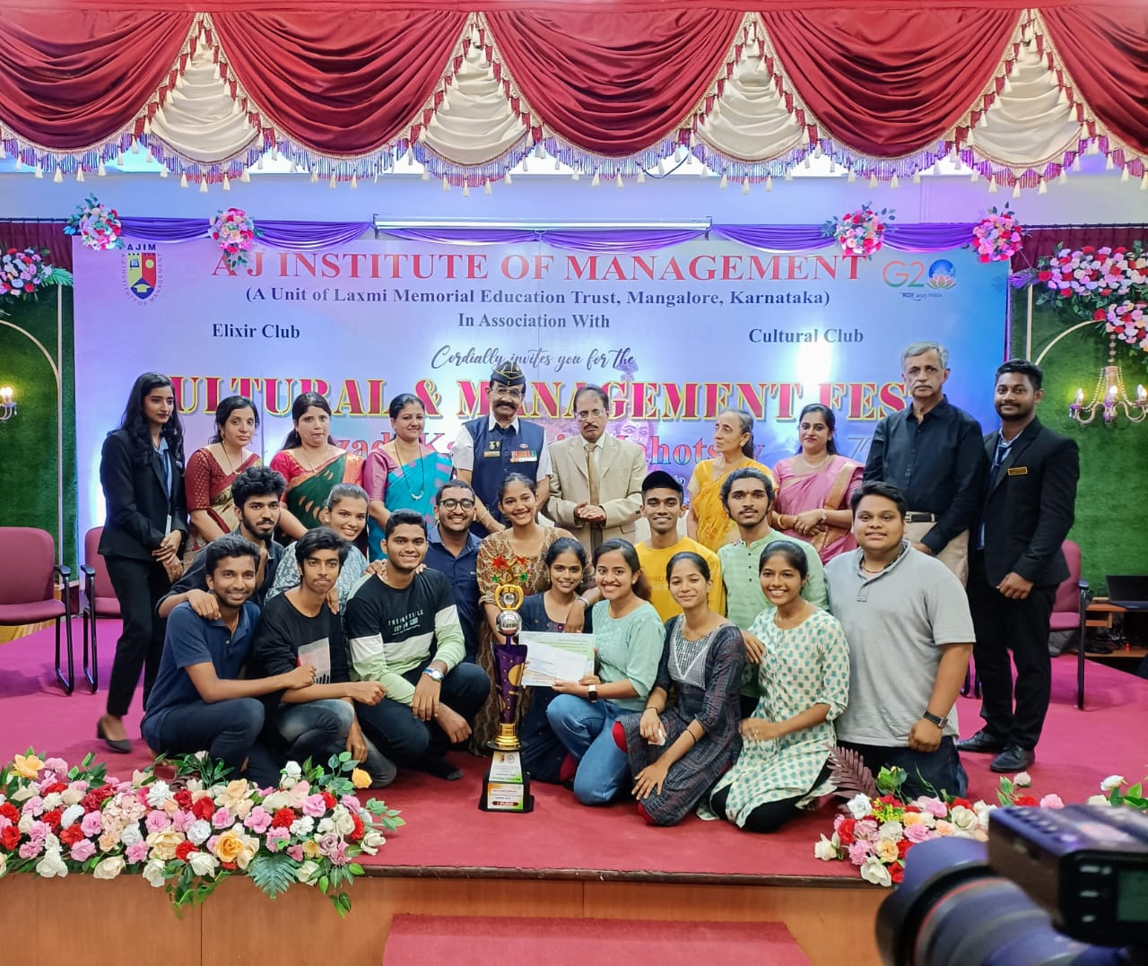
19. "JASHAN-2023" Express your creativity, inter collegiate fest organized by AJ Institute of Management, Mangalore held on 19th April 2023.
• Our Team won 1st place in group dance and singing.

Slide 18
20. "Singing Competition“
Organized by SMS College Bramhavar
on 24th May 2023.
-Secured 1st place in Deshabakthi Geethe. and in Classical Singing.

Slide 19
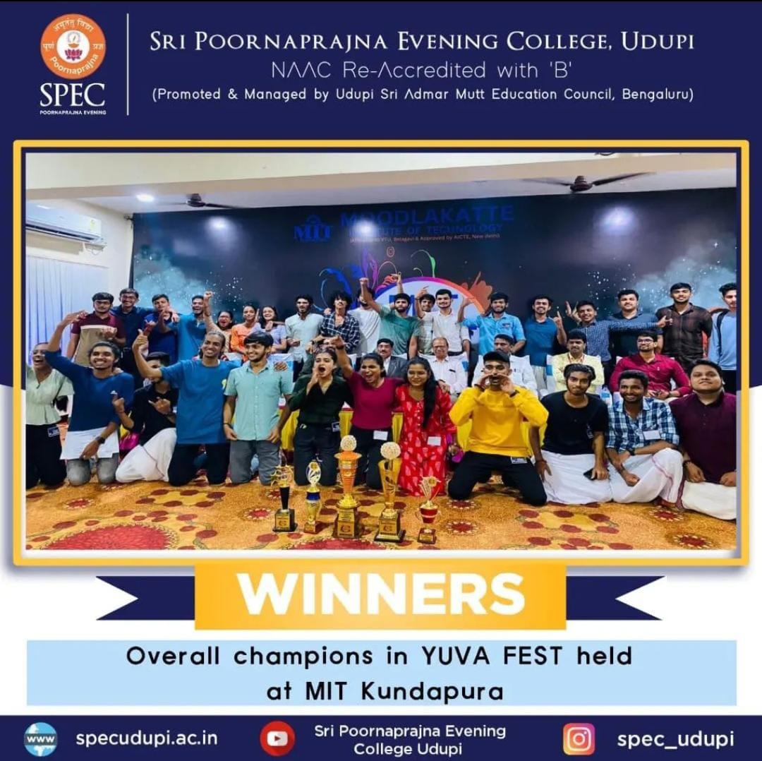
21. "YUVA-2023"
Management and cultural Fest organized by Moodlakatte Institute of Technology, Moodlakatte held on 25th may 2023.
Secured 1st place in Mad add, Quiz, Hash Tag and in Variety.

Slide 20
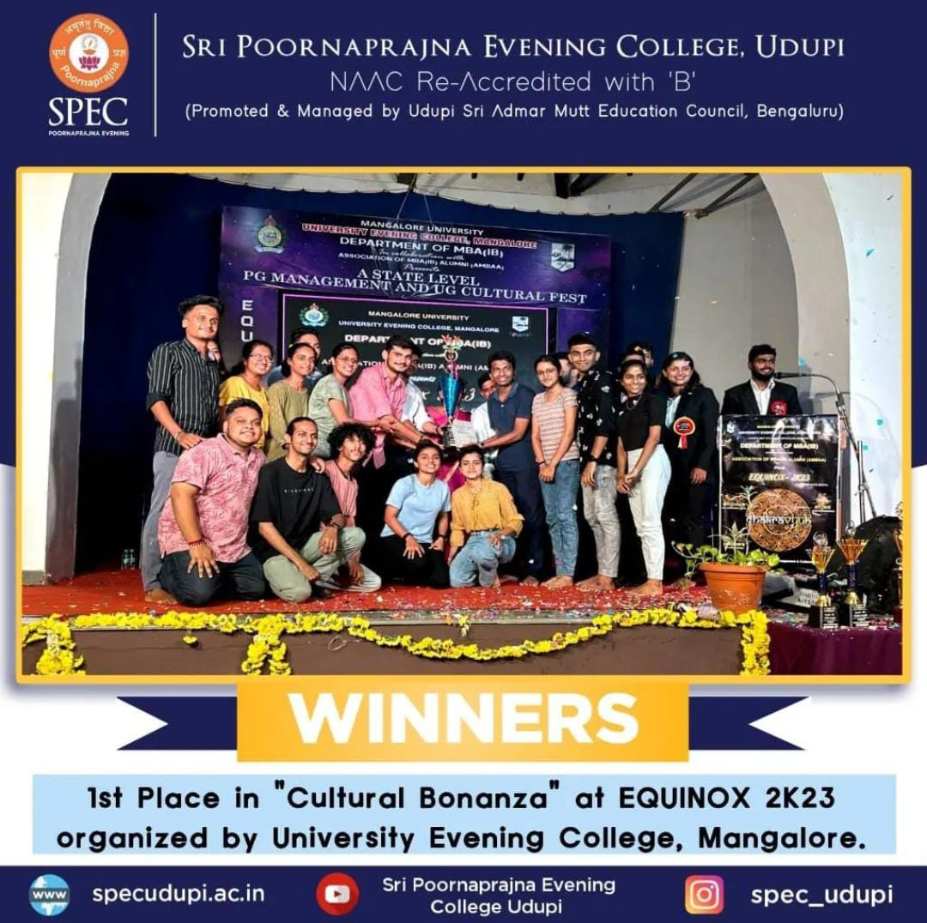
22. "EQUINOX-2023" A State level PG management & UG cultural Fest, organized by University Evening College, Hampankatta Mangalore, held on 27th May 2023.
Secured 1st place in cultural Bonanza

Slide 21
Secured 3rd place, in Udupi district level Folk Competition-2023, in the event, Folk Song Competition, held on 18-06-2023

Slide 22
23. "Sahyadri Whiz Quiz 2023" A national level Quiz competition organized by sahyadri College of engineering and management, Mangalore on 2nd june 2023. Our students participated in Quiz Competition.
24. "DIGANTA" organized by Govinda Dasa College, Surathkal on 3rd June 2023. Our students participated in elocution competition, Posture making and Face painting events.
25. “ABHIJNA” Fest organized by PG department of Sri Poornaprajna College, Udupi on 9 June 2023.
• secured 1st place in Quiz competition and reels making.
• secured 2nd place in Mad ads.
The College also won “overall Runner up” for the event.

Slide 23
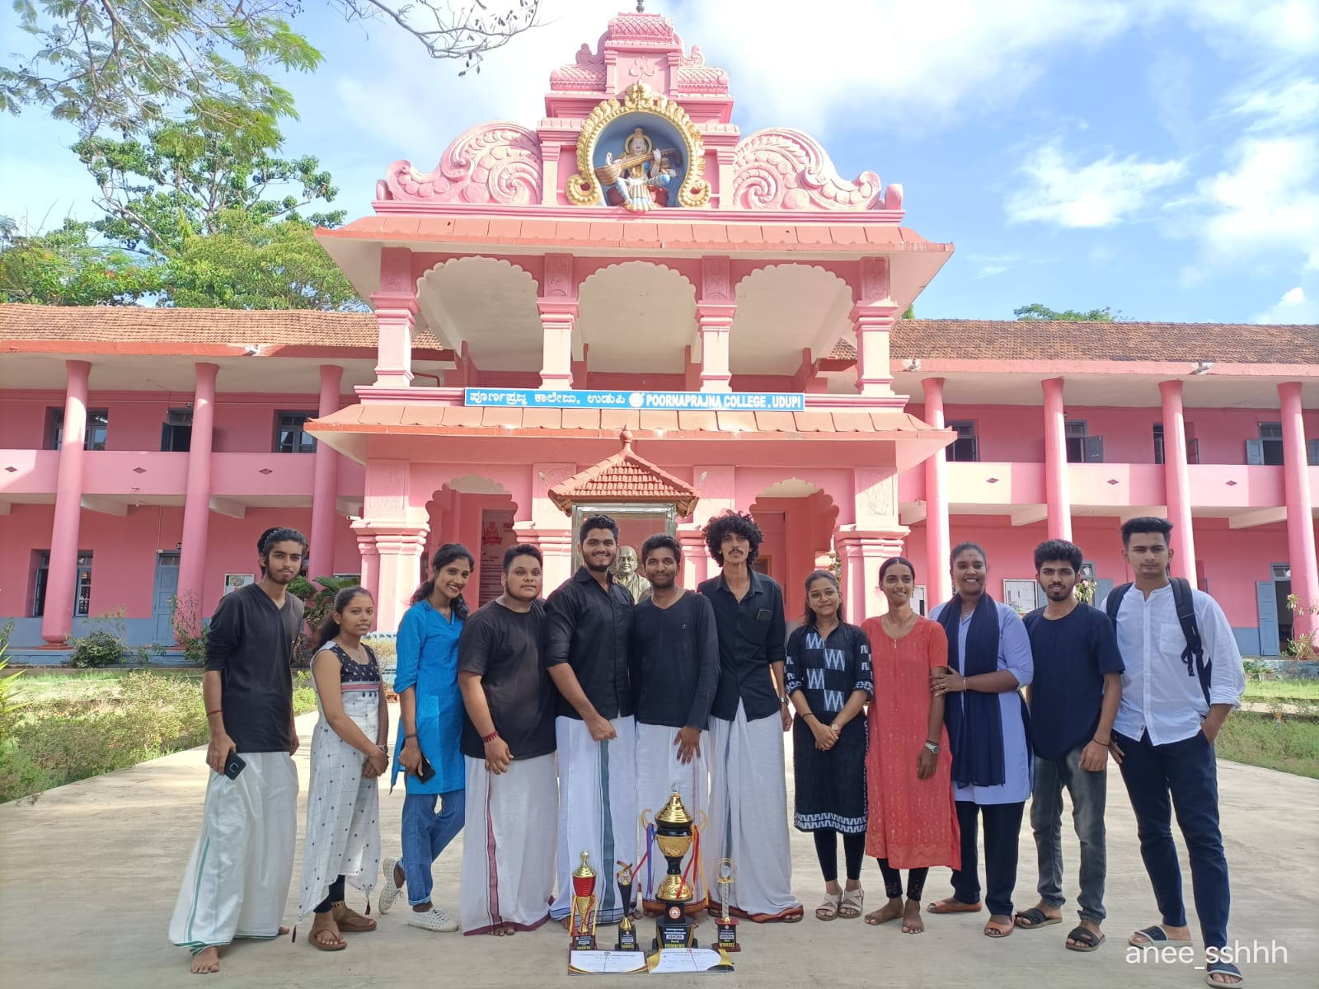
“ABHIJNA”

Slide 24
PG Students Achievements
1. Team M.Com got “Overall Runner's up Prize” at National Level Commerce and Management "Fest 2023 - Magnum" organised by Department of Commerce Mangalore University, Konaje.
• won First prize in Finance event.
• won the Best Manager event.
2. Team M.Com participated at the State level Commerce and Management fest “Playstore 2023” held at Manjunath Pai Memorial Government First Grade College of Professional & Business Management, Karkala. Participated in Best Manager event and in Finance Event and Quiz Event and secured First place.
3. "Unifest 2023 Spellen" held at Department of PG studies in Commerce of University College Mangalore on 6 June 2023.
Won the Best manager event.

Slide 25
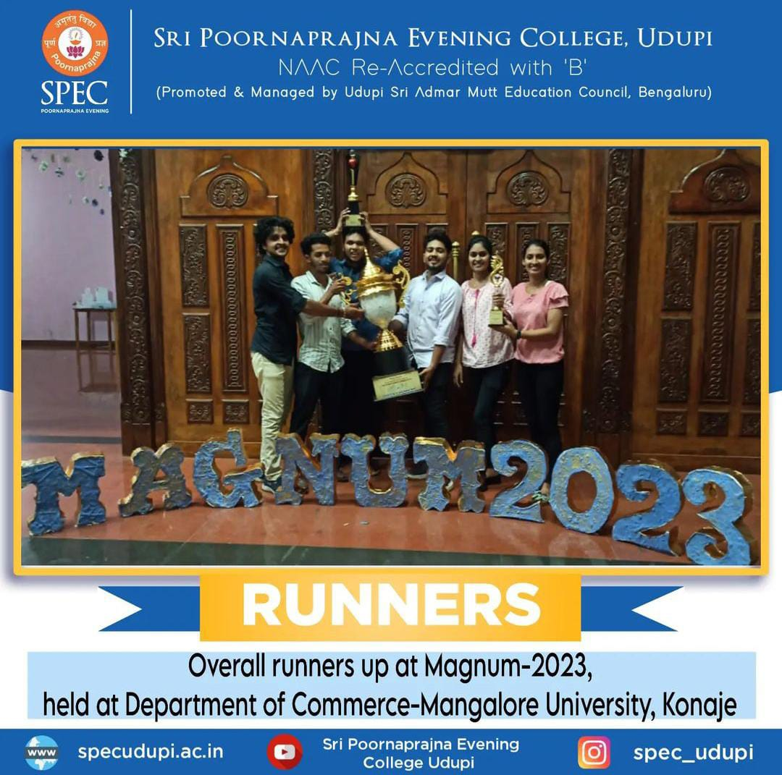
“MAGNUM 2023”

Slide 26
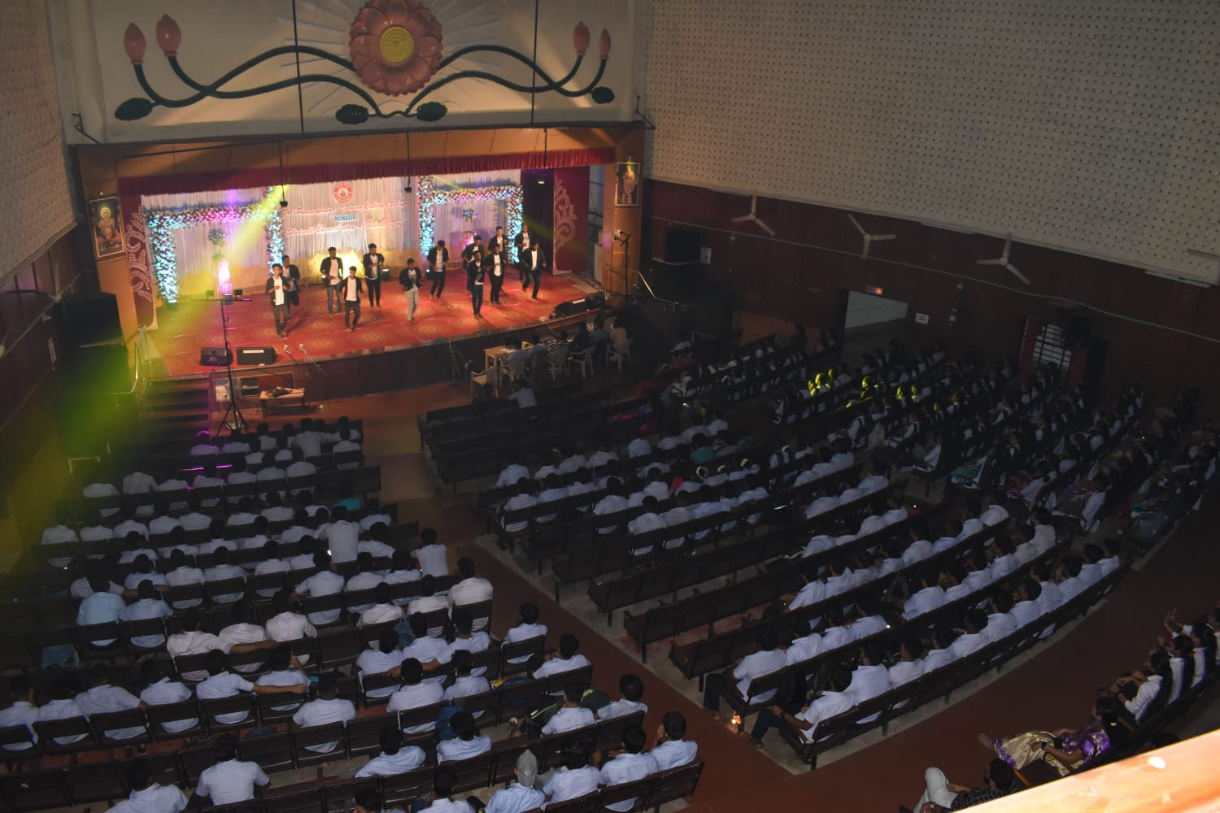
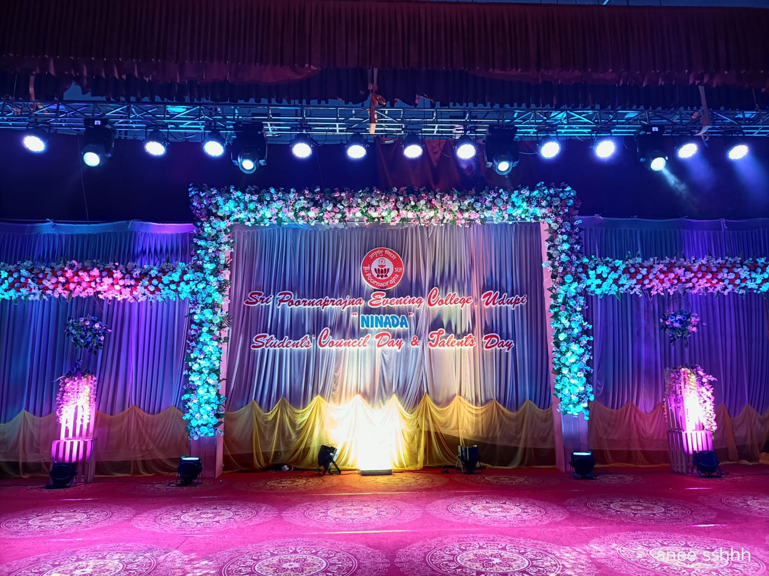
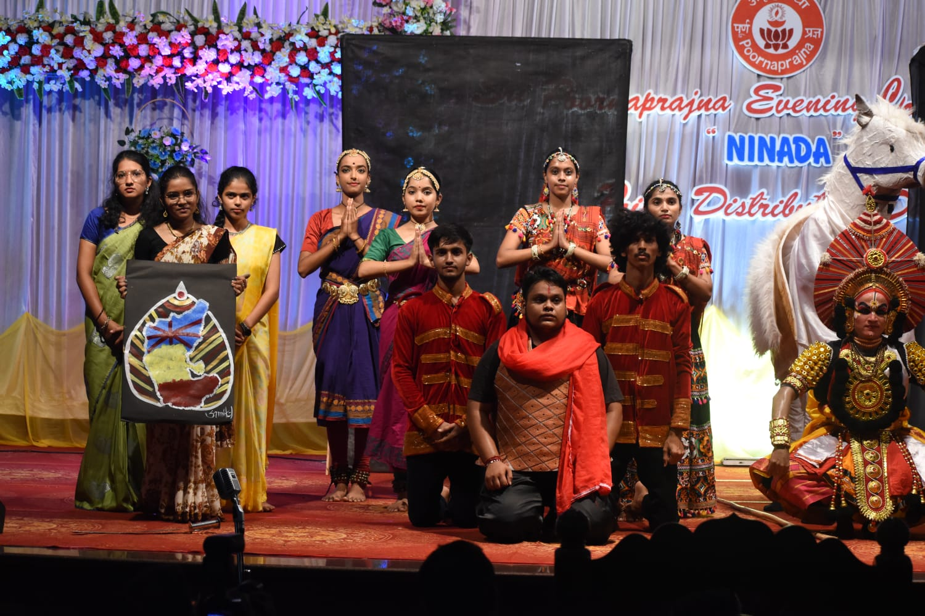
"Unleashing Brilliance: Celebrating Talents at our College!"

Slide 27
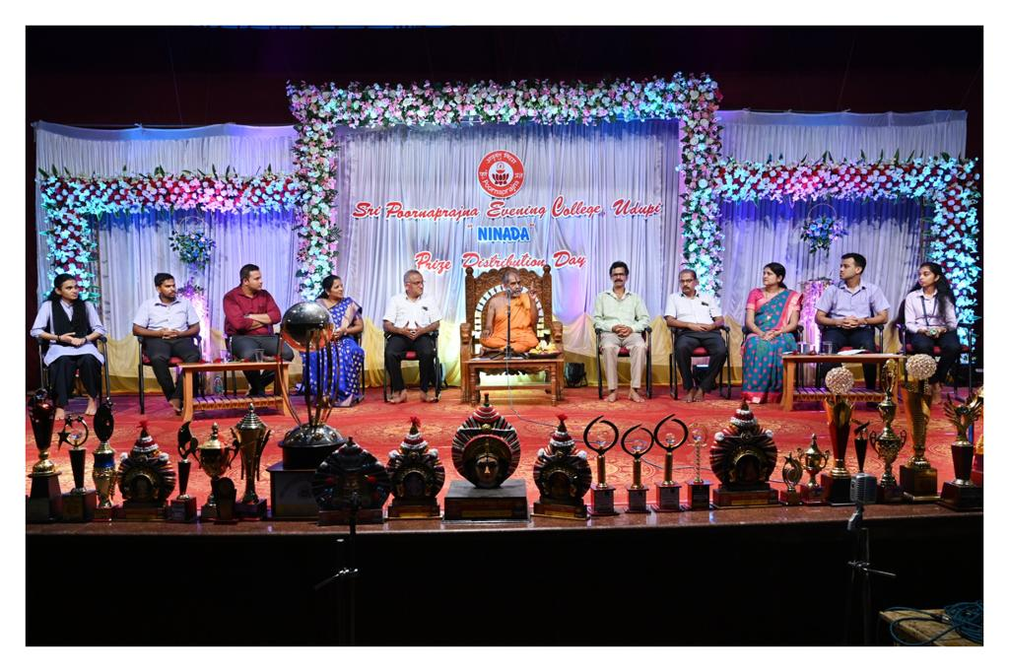
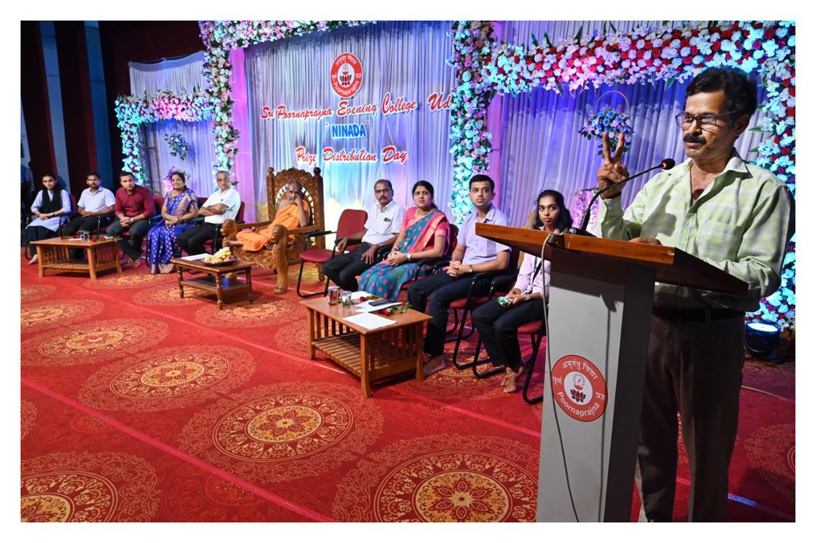
"Celebrating Excellence: Honoring Achievement on Prize Distribution Day"

Slide 28
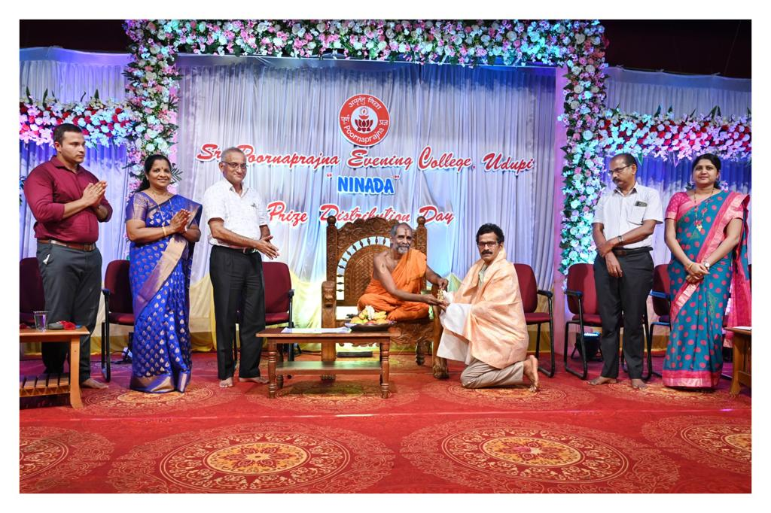
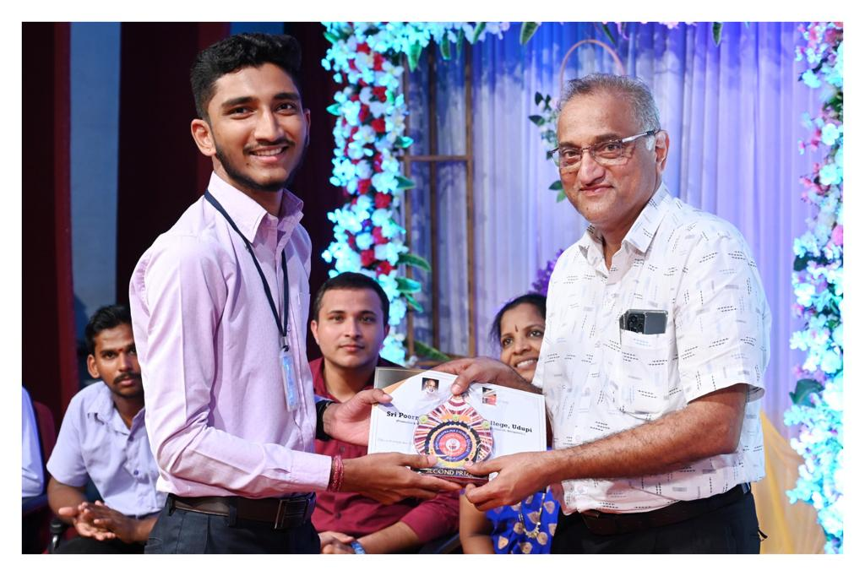
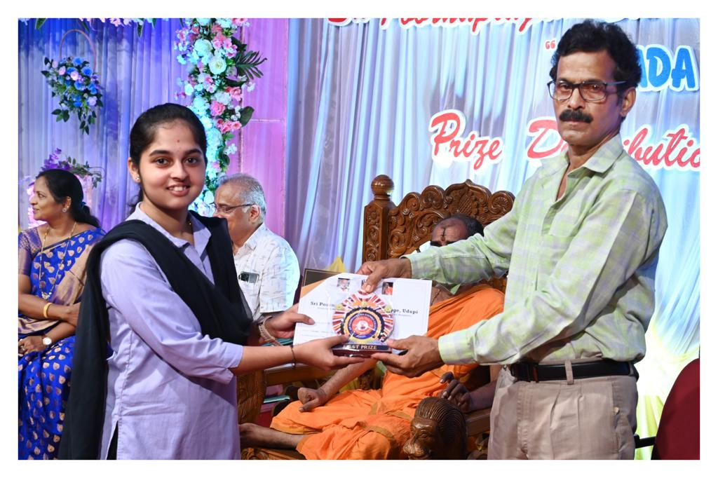
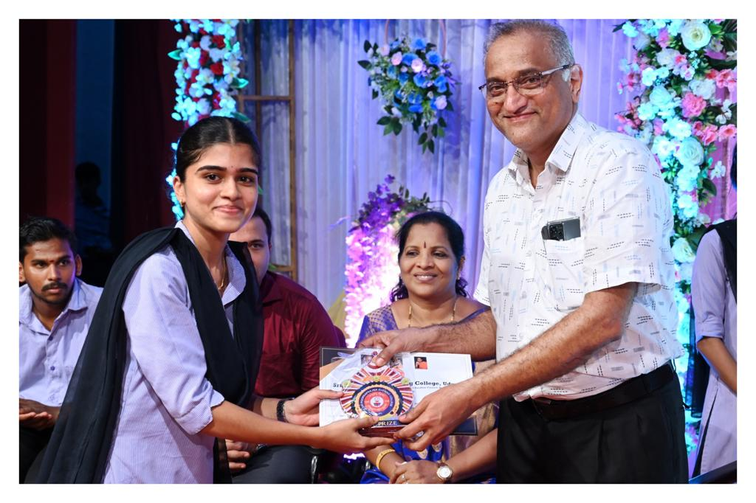

Slide 29
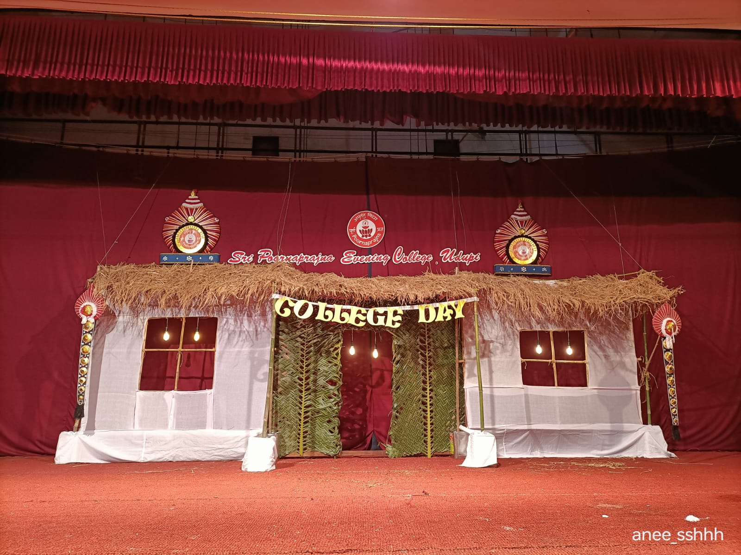
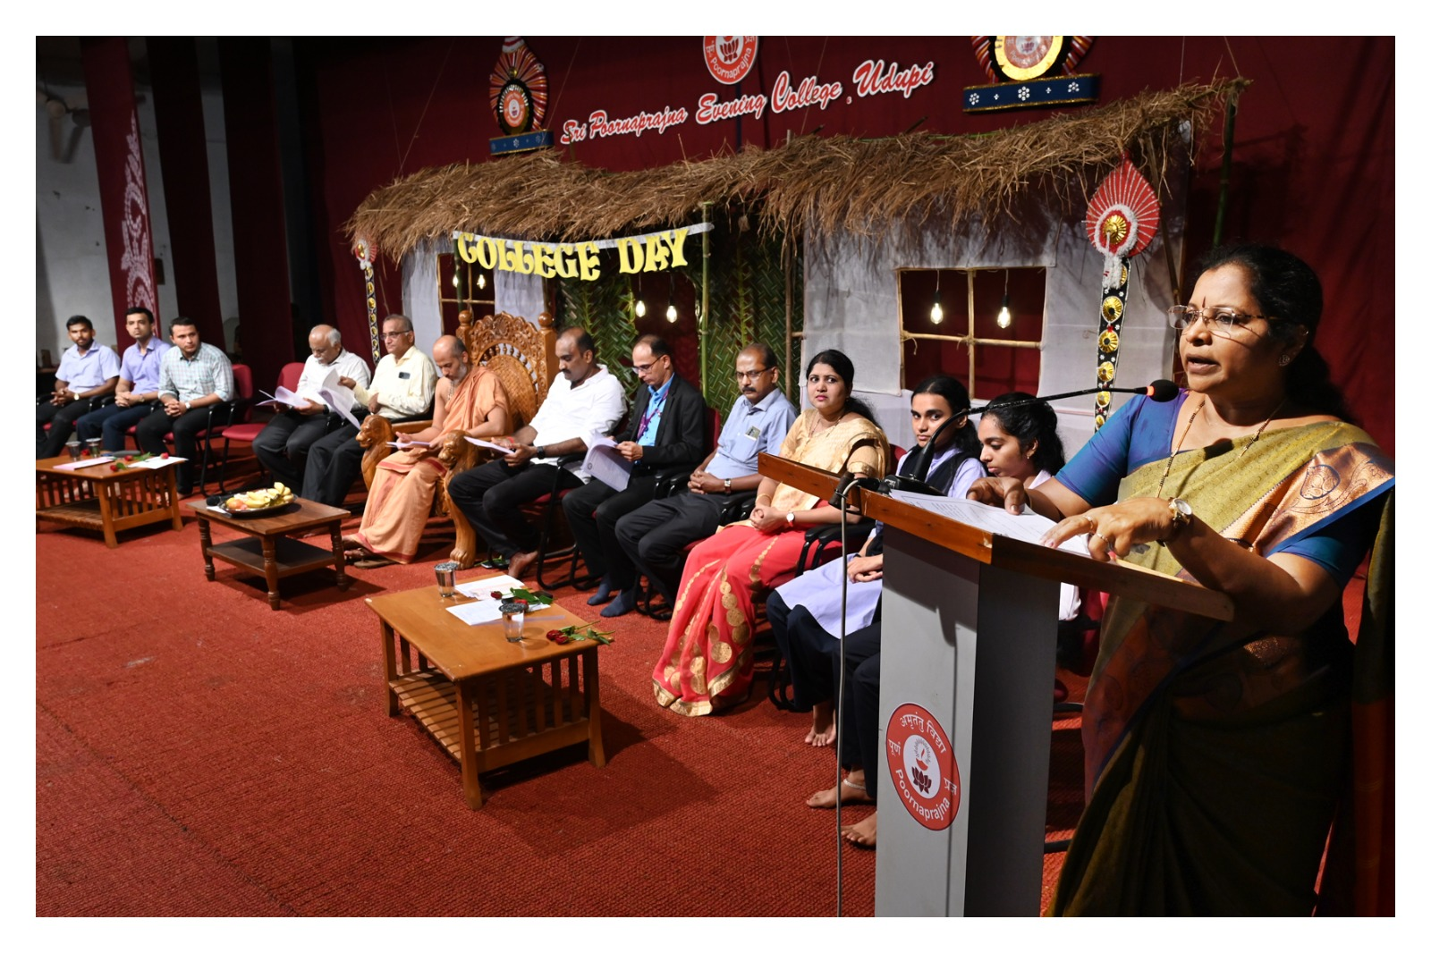
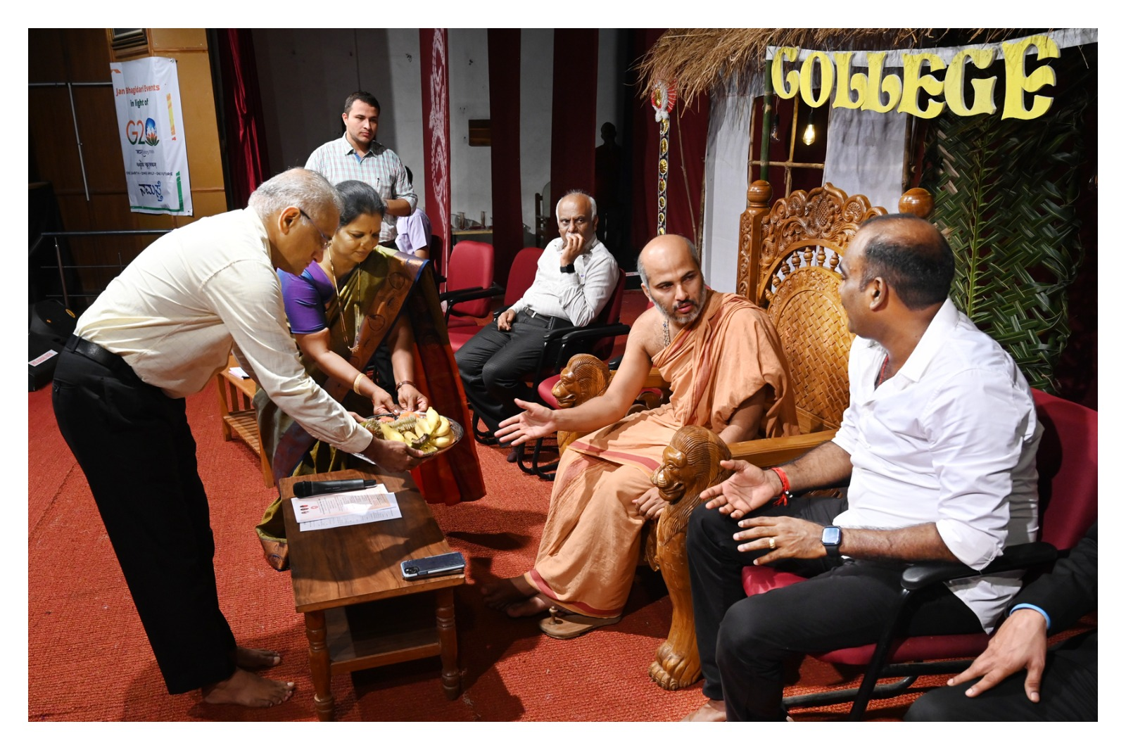
College Day Celebration

Slide 30
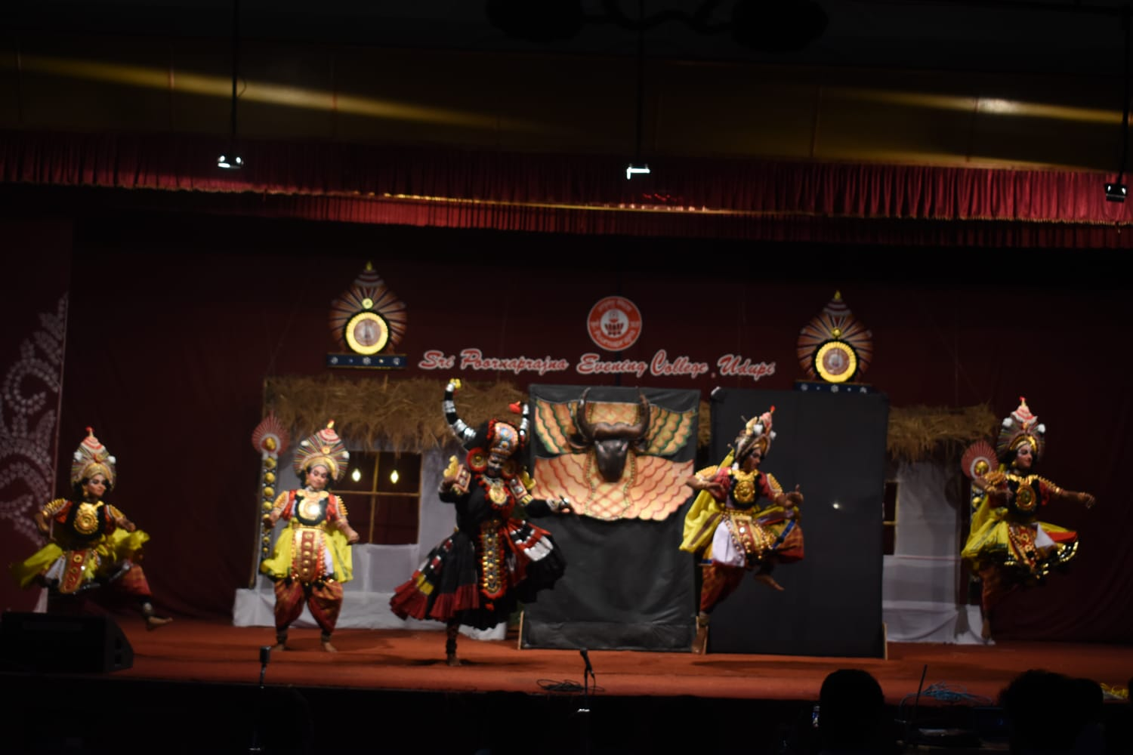
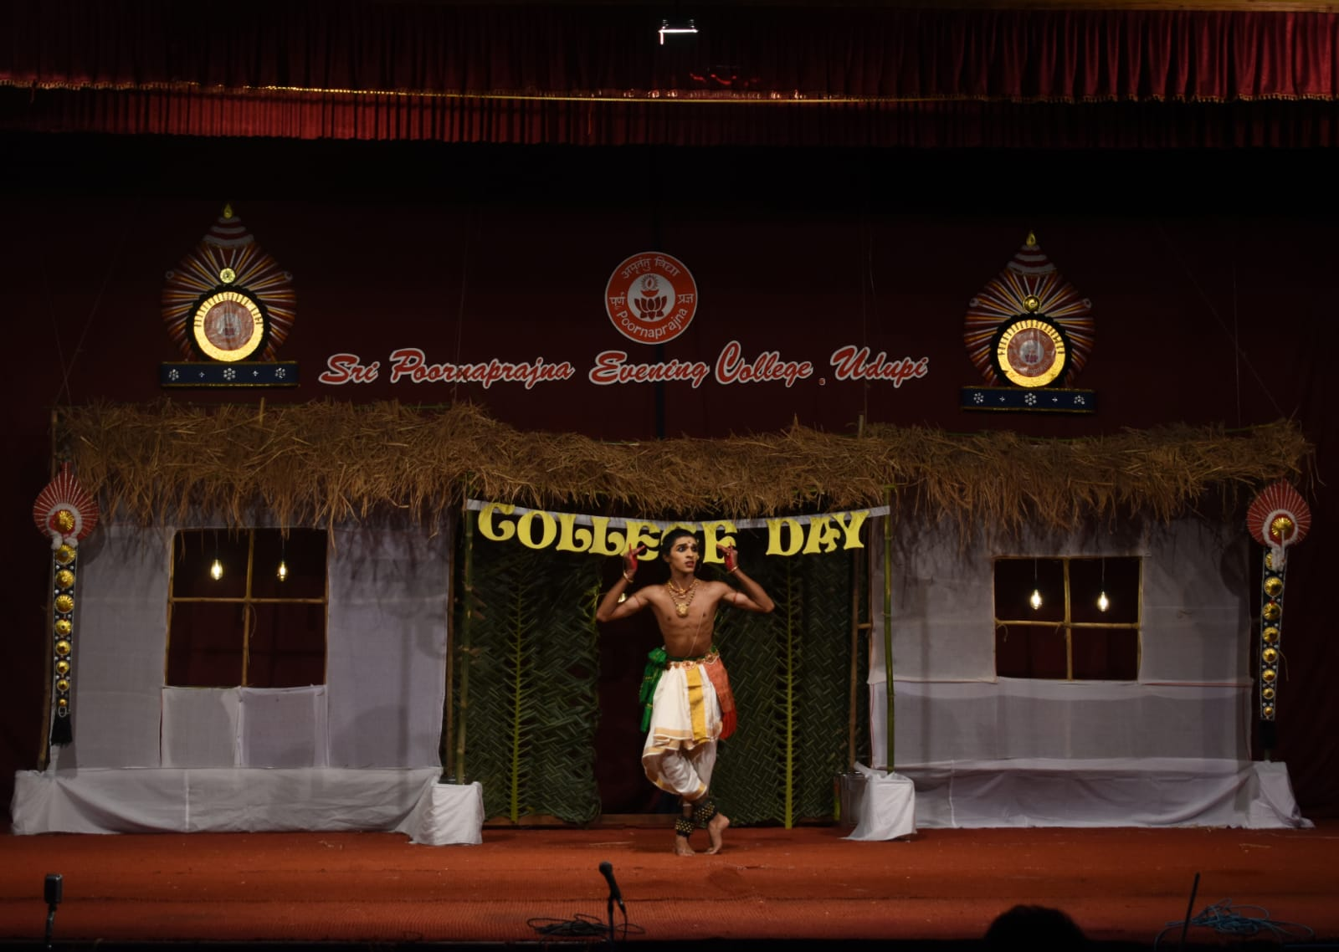
A Spectacular Cultural program presented by our college students.

Slide 31
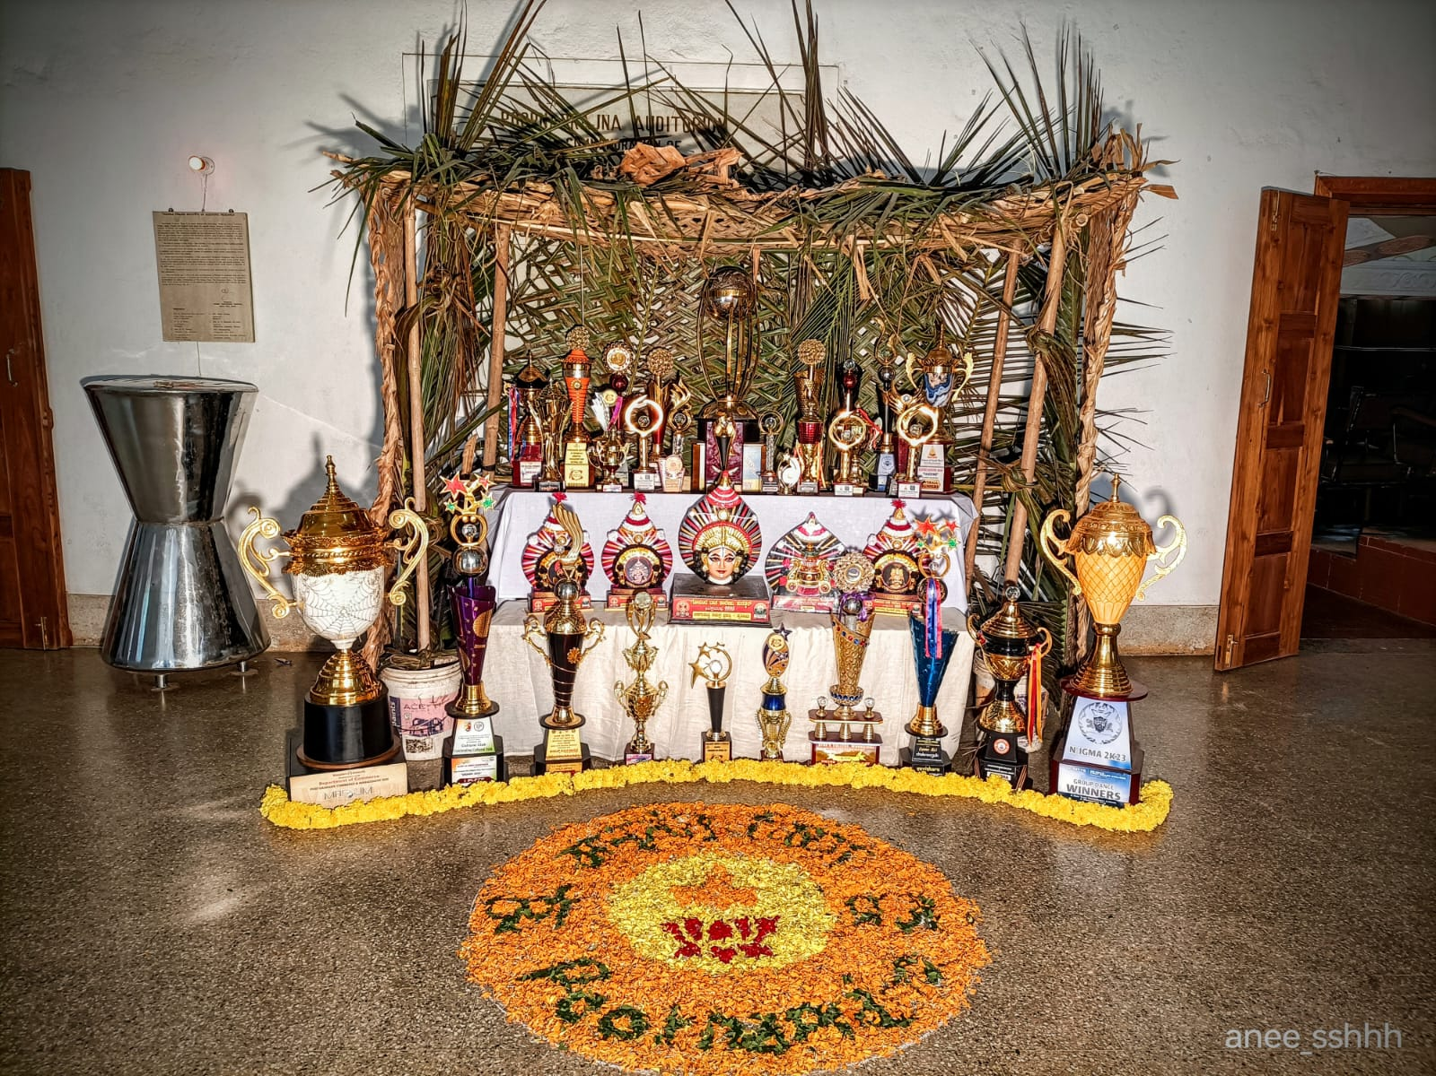
Trophies won by the college, at various Events

